Slide 1

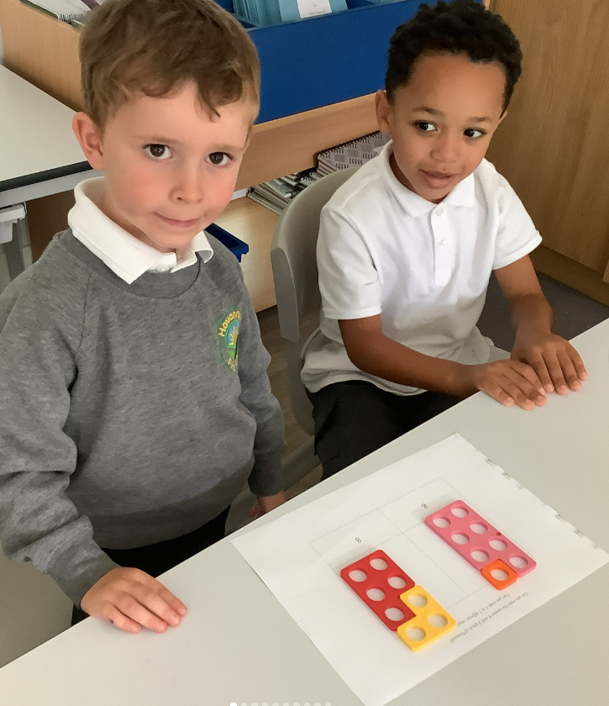
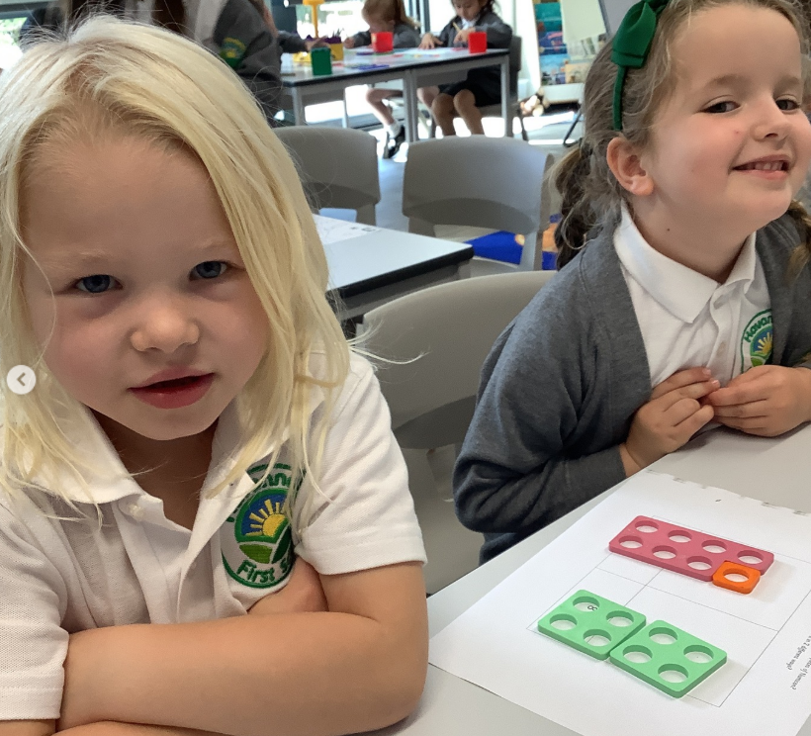
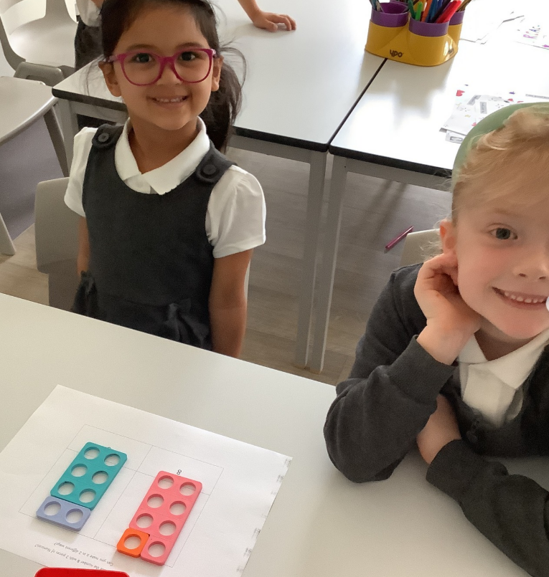
Maths at Havannah First School
Challenge, Equality & Opportunity

Slide 2
Mastery – What is it?
Mastery in Maths is being able to understand and apply knowledge to different contexts and situations.
It can also be explaining thought processes, as well as, proving and giving reasons for answers.
This approach aims to broaden children’s understanding of a concept, enabling them to use what they know in new situations.

Slide 3
Stages of Mastery
Fluency in Maths happens when children can answer questions accurately using recall of Mathematical facts.
Reasoning is when a child can explain what they have done and why, or prove that something is or isn’t correct.
Problem solving is applying their knowledge and understanding to multi-step problems.

Slide 4






Examples of Fluency questions
Which is longer?
2) Which is taller?
3) Who is shorter?
Sam
Jo

Slide 5

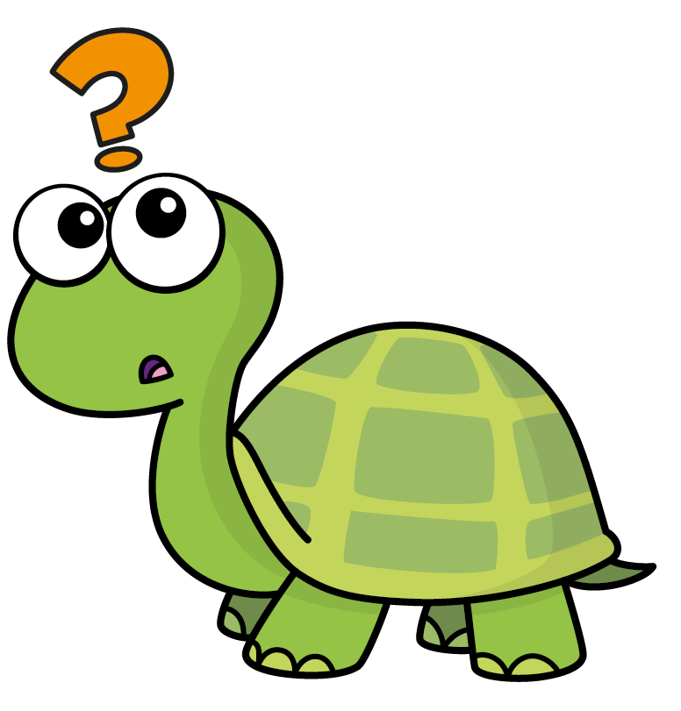

Examples of Reasoning questions
How long is the line?
The line is 4 cubes long.
Do you agree with Tiny?
Have a think

Slide 6
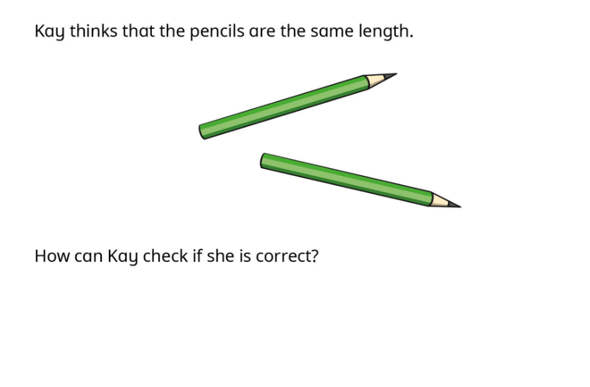
Examples of Problem- Solving questions

Slide 7
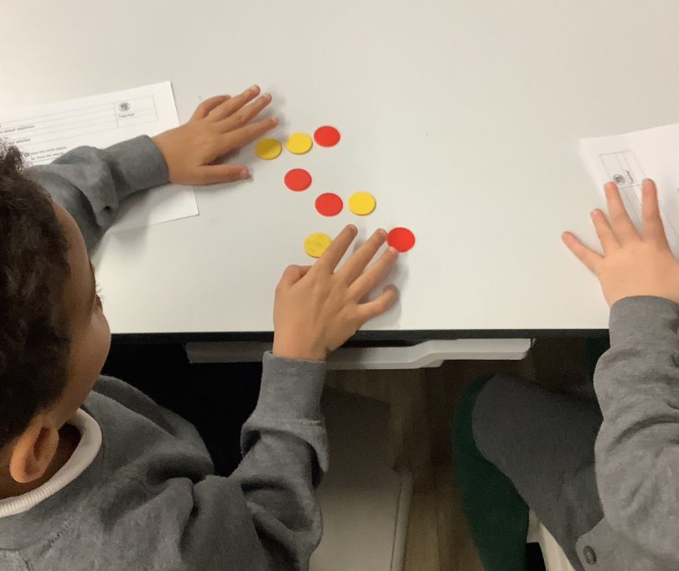
Stages of Teaching
Maths learning should follow a process, moving through each stage when the child is ready.
If the child is moved too quickly through the concrete and pictorial stage of their learning, this could affect understanding in later years.
Concrete
Pictorial
Abstract

Slide 8
Concrete
Pictorial
Abstract
What it is: This is the "hands-on" stage where children use physical objects to represent a problem.
Year 1 example: To teach subtraction, a teacher might give a child 9 blocks and ask them to take away 2 blocks to see how many are left.
Why it's used: This provides a foundational, real-world understanding of the concept before moving to more abstract methods.
What it is: Children move from using real objects to creating representations, such as drawings, diagrams, or pictures.
Year 1 example: After using the blocks, the child would be shown how to draw the 9 blocks and then cross out 2 of them to represent taking away.
Why it's used: This bridges the gap between the concrete and the symbolic, allowing children to visualize the process.
What it is: Children use mathematical notation and symbols (like +, -, x, /) to represent the problem.
Year 1 example: The child will learn to write the calculation "9 - 2 = 7" after understanding the concept through the previous stages.
Why it's used: This is the final stage, where children are using purely symbolic representation. A child will only progress to this stage when they have a solid grasp of the previous two.

Slide 9
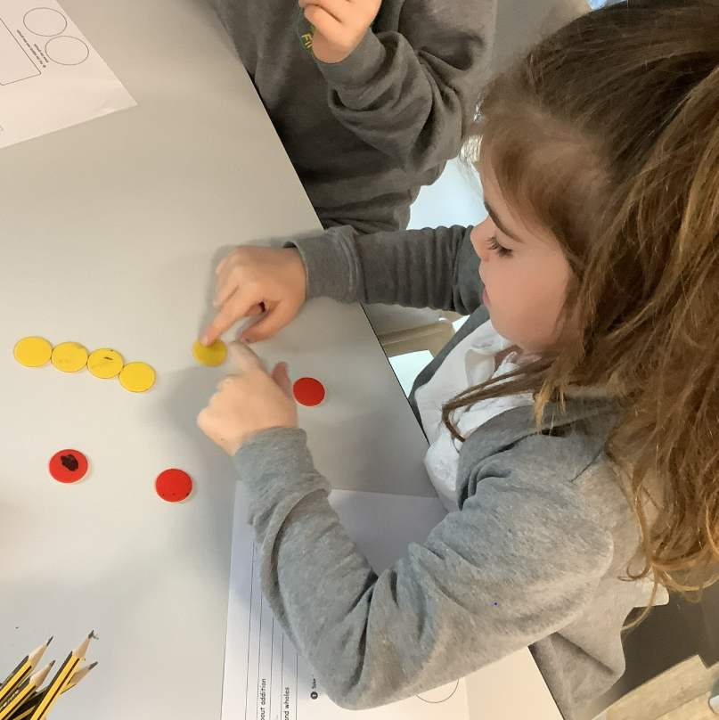
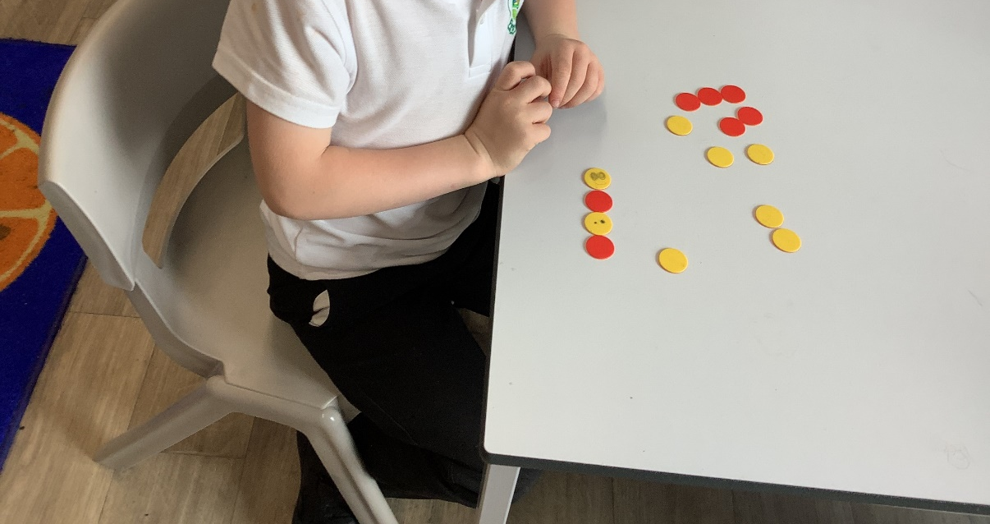
How Maths is taught at Havannah
In KS1 and 2, Maths is taught 5 times in a week.
Schemes of learning are based on the White Rose Maths Schemes of Work and support our school’s mastery approach to teaching and learning and are consistent with the aims and objectives of the National Curriculum.
Number is at the heart of our schemes of learning and a significant amount of time is spent reinforcing number in order to build competency and ensure children can confidently access the rest of the curriculum.

Slide 10
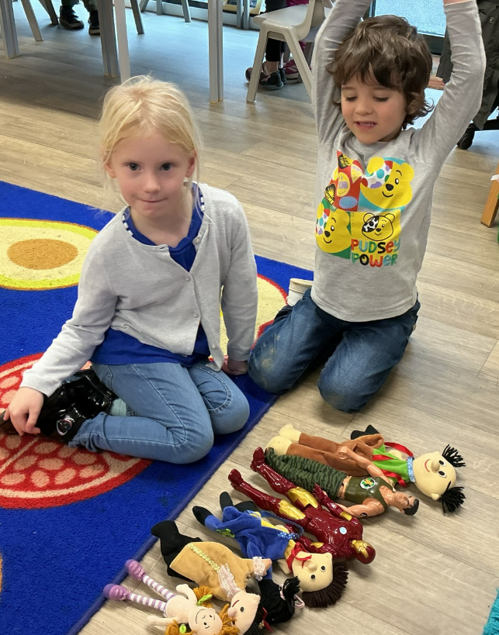
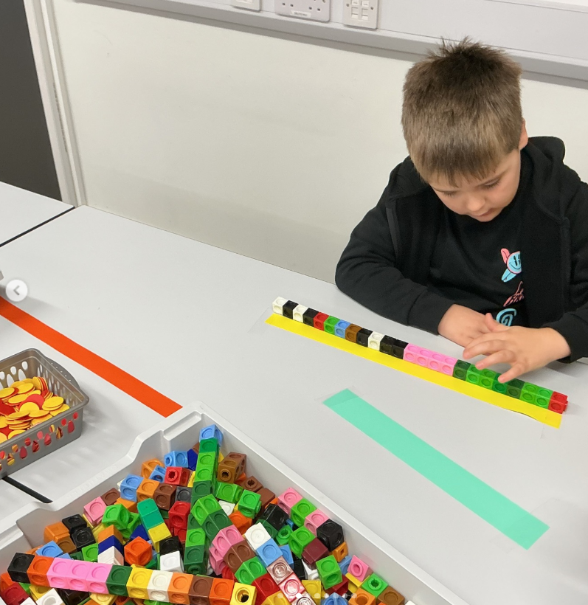
Children stay within the required year group so that they acquire depth of knowledge in each topic.
Children progress through schemes of learning as a whole group, encouraging children of all abilities to support each other in their learning.
The vast majority of children progress through the curriculum at a similar pace.
Questioning, marking and feedback of work helps to identify those children who need further support/to address misconceptions/make corrections.

Slide 11
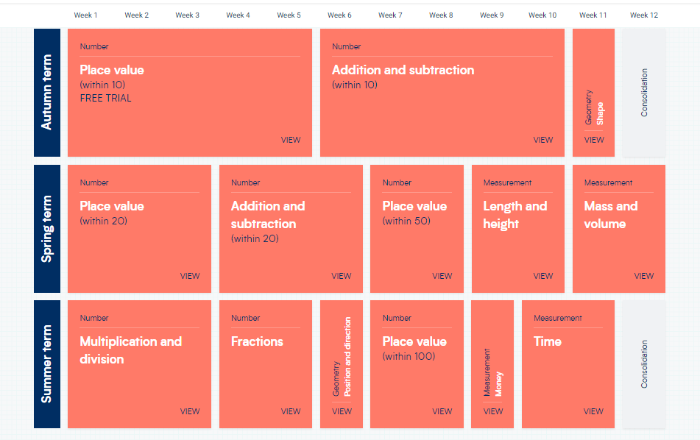
Long Term Plan for Maths

Slide 12
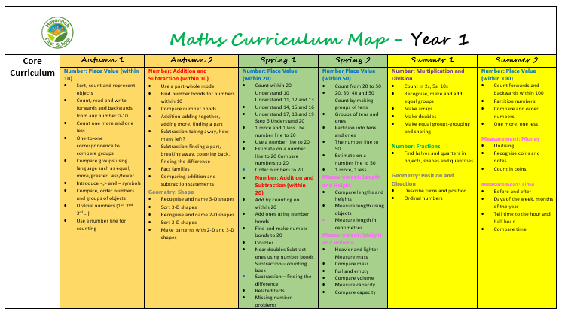
Small Steps in Maths

Slide 13
Vocabulary
Number and Place value: 20-100 count (on/up/to/from/ down), least, fewest, smallest, greater, lesser, equal to, odd, even, units, tens, ten more/less, digit, numeral, figure(s), compare (In) order/a different order, size, value, between, halfway between, above, below.
Addition and subtraction: number bonds, addition, plus, sum, greater, inverse, near double, halve, is the same as, (including equals sign), difference between, how many more to make..?, how, many more is…than..?, how much more is..? subtract, minus, how many fewer is…than..?, how much less is..?

Slide 14
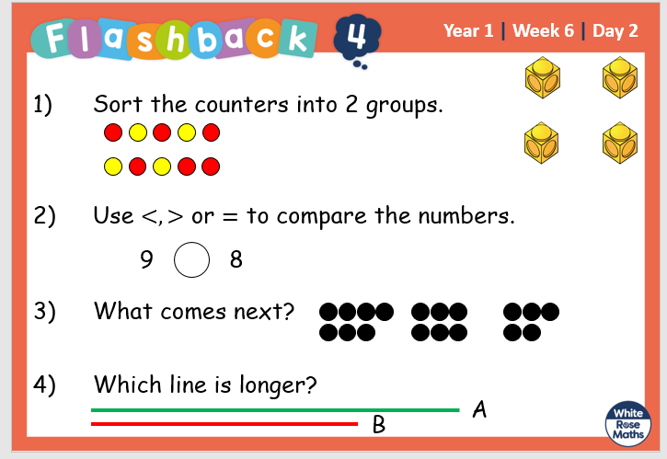
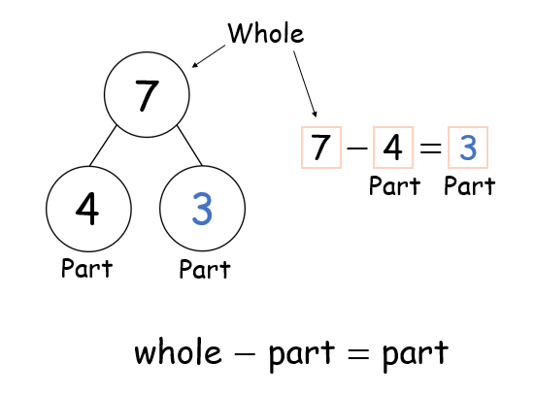
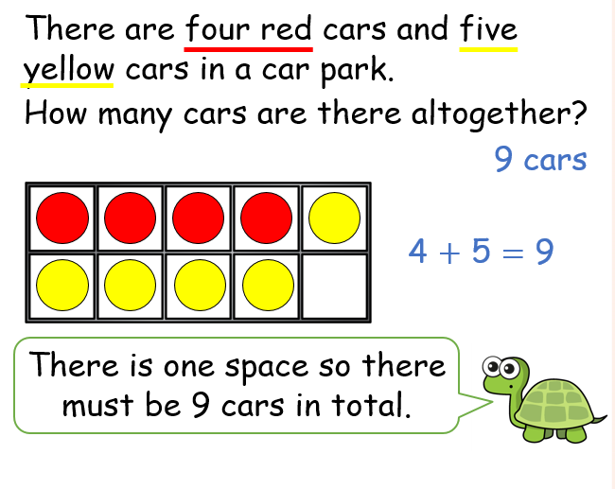
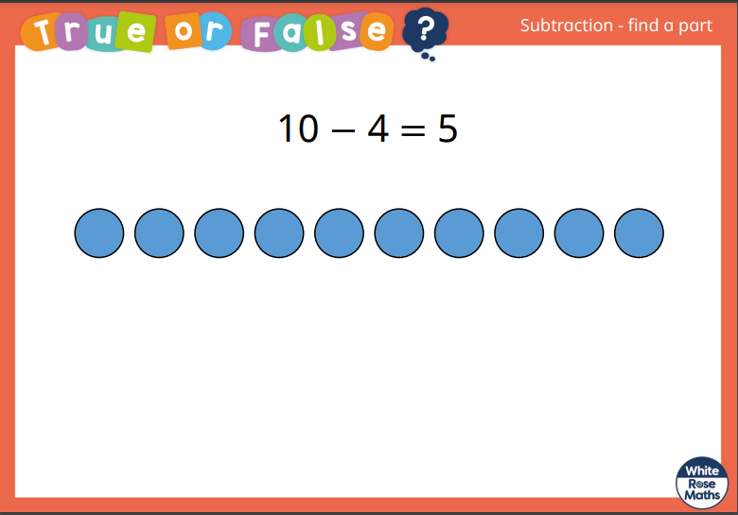
A typical Maths lesson at Havannah First School
Each Year 1 lesson typically follows the following format:
Flashback 4 (Daily retrieval – questions based on last lesson, last week, two weeks ago and further back)
A talk activity – what do the children know. Building on previous knowledge.
A starter activity – practice skills needed for main activity and an introduction to key vocabulary.
A range of questions which develop reasoning skills and independent use of strategies
Independent Practice – Fluency/Reasoning and Problem Solving questions in book.
Recap of lesson/True or False Question.

Slide 15
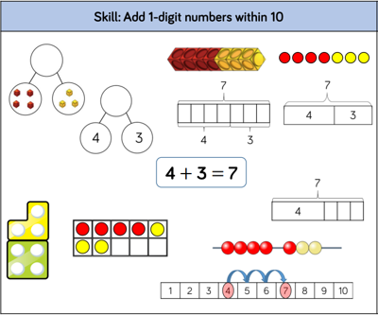
Example of Year 1 – teaching strategies for adding 1-digit numbers within 10

Slide 16
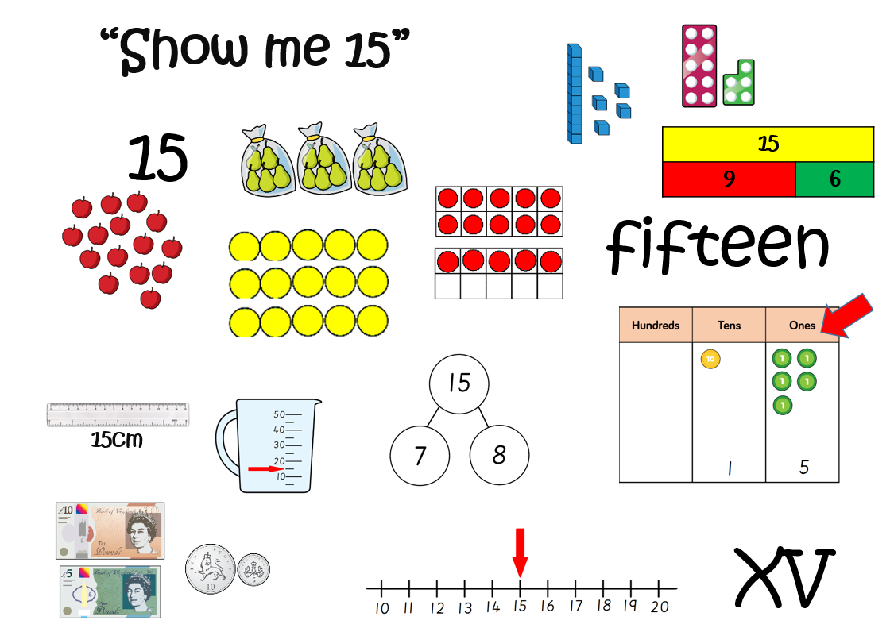

Slide 17
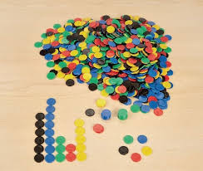
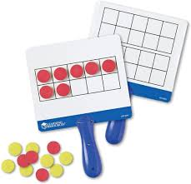
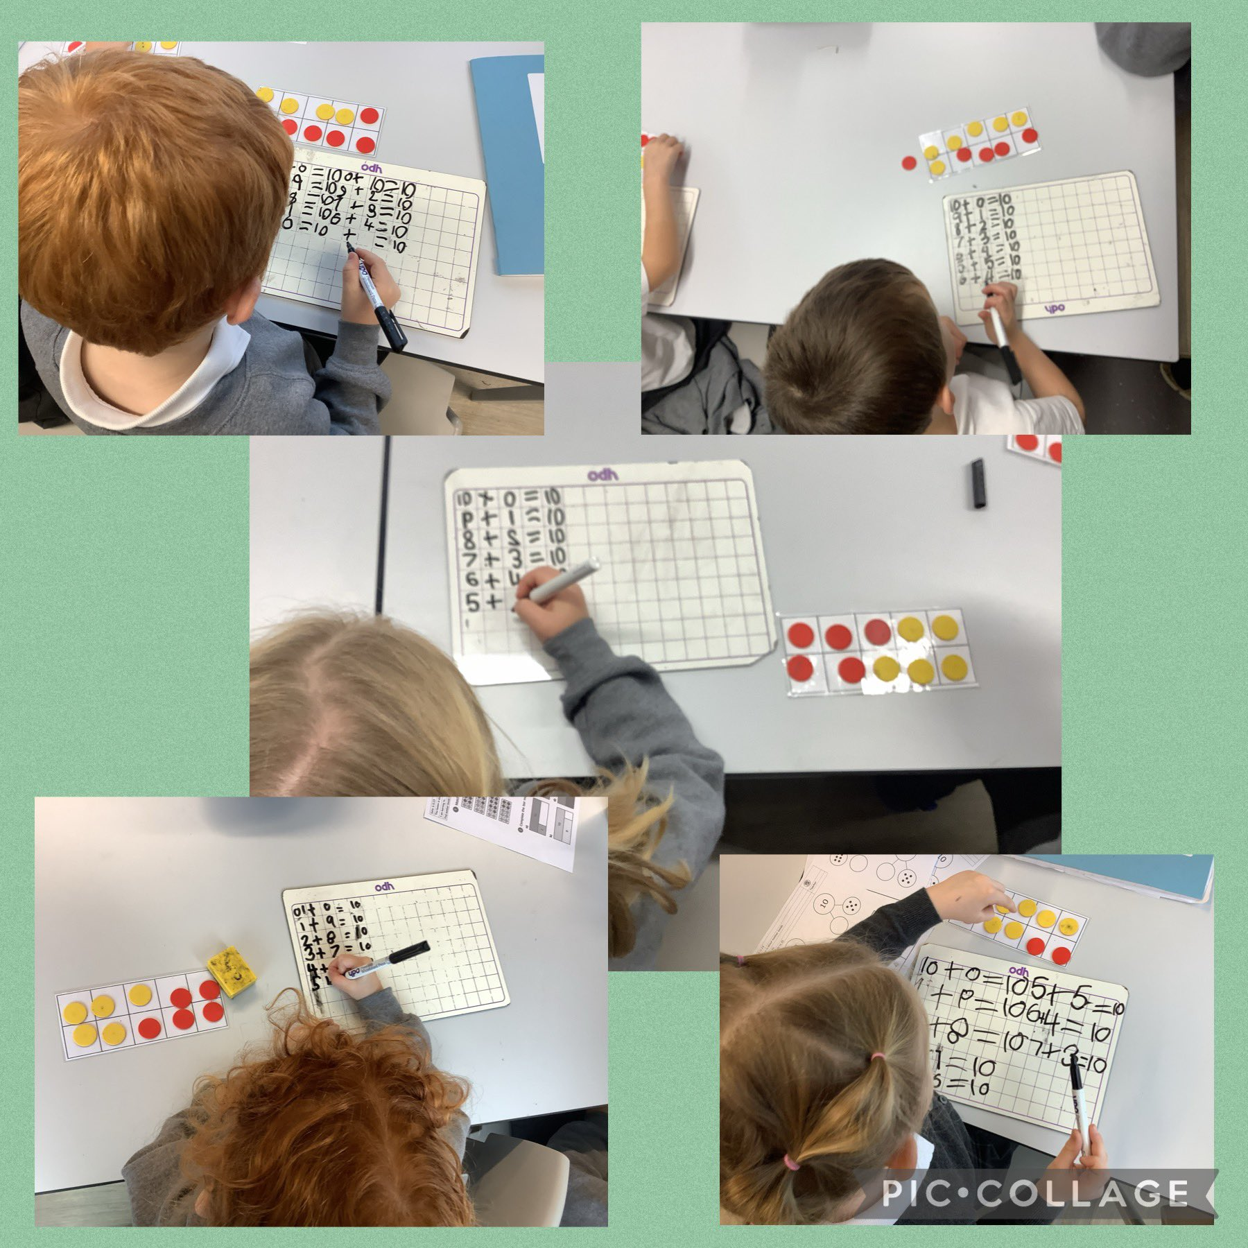
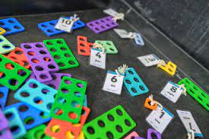
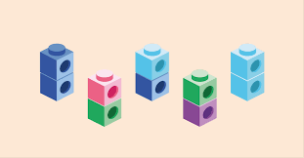
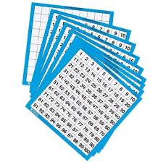
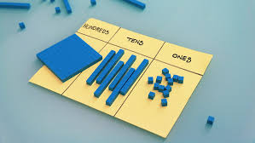
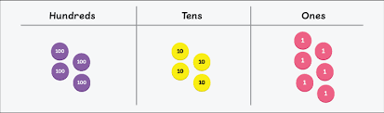
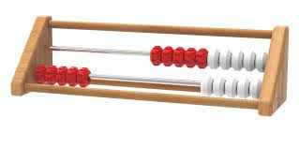
Manipulatives we use in school to aid our learning

Slide 18

Helping your child at home…
Point out that Maths is all around us in everyday life. Include your child in activities involving numbers and measuring, such as shopping, cooking and travelling – telling the time, managing money etc...
When you look around, everything is made out of shapes. Children could identify car wheels as circles, windows as rectangles and even tiles as hexagons or whatever shape they may be!

Slide 19
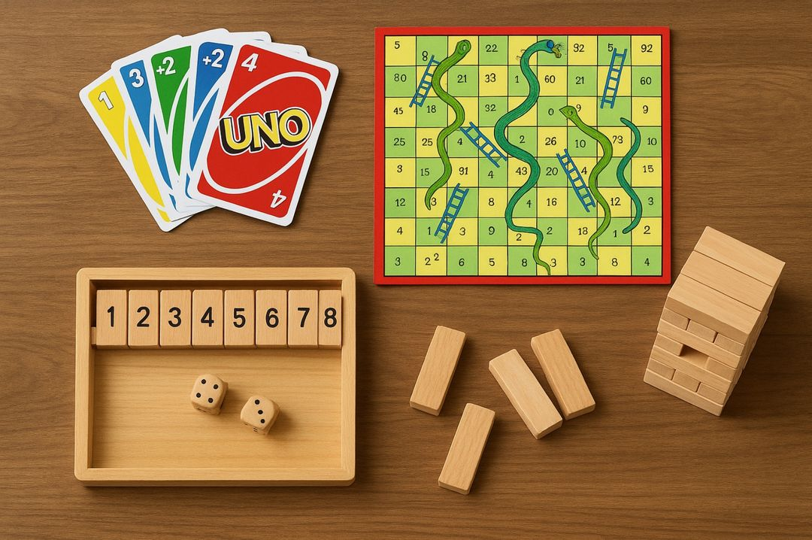
Games are a great way to bond with your children, but also many games use mathematical and logical skills that your children will need in later life. Even a simple jigsaw puzzle helps children to develop logical and spatial awareness skills. Furthermore, games like snakes and ladders enable children to count the rolls of the dice, which helps develop their counting skills.

Slide 20

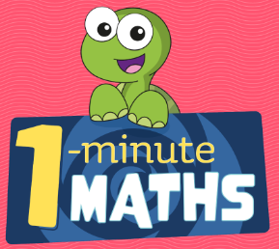
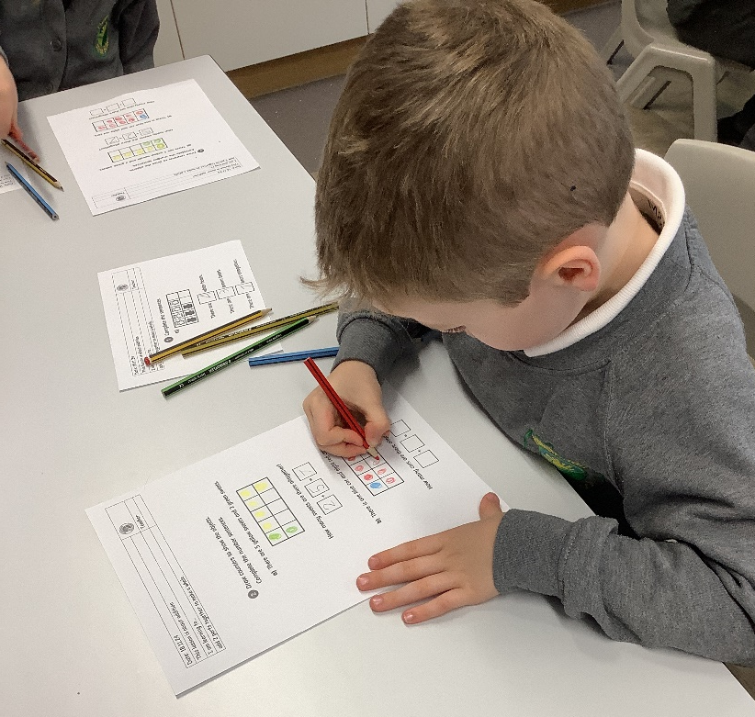
Find out more about our work on the school website or at : www.whiterosemaths.com
Download the White Rose ‘1-Minute Maths’ app
– great for fluency in number facts and FREE.
Thank you for attending – if you have any questions then
please do get in touch with the class teacher, Mr Burnett,
our Maths Lead or visit the curriculum section on our
website and follow the links to maths.

