Slide 1
Find us online...
@rise.ne
@rise_mhst
Sleep Hygiene
Parent/Carer presentation
bit.ly/Rise-ne
rise.childrenssociety
.org.uk/
Notes:
​Introduce self and Rise.

Slide 2
Sleep Hygiene: Aims of session
What is sleep? Why do we sleep?
How much sleep is needed
Stages of sleep
Effects of lack of sleep
Relationship between sleep and learning
Sleep hygiene for a better night's sleep
Mindfulness
Gratitude
Common sleep problems
Sleep hygiene and sleep routines

Slide 3
What is sleep?
Sleep is essential to the healthy development of children and young people
Sleep is vital to our well being for our body to repair itself when we rest
Sleep is essential for mental well being and functioning
Good sleep helps our learning

Slide 4
Relaxation
Good Relationships
Hobbies
Health
Sleep
Essential ingredients for wellbeing
Notes:
Having the right ingredients means that we can maintain good mental health and helps us be resilient and able to deal with transitions better.
Talk through these – why do they feel they are important?

Slide 5
Why do we sleep?
Sleep is essential to the healthy physical, intellectual and emotional development of children and young people
Sleep is needed so children can consolidate what they have learned
If we do not sleep we can be grumpy and our ability to cope is reduced
Good sleep helps our learning, memory and focus
Just like a mobile phone we need to recharge to function at our best

Slide 6
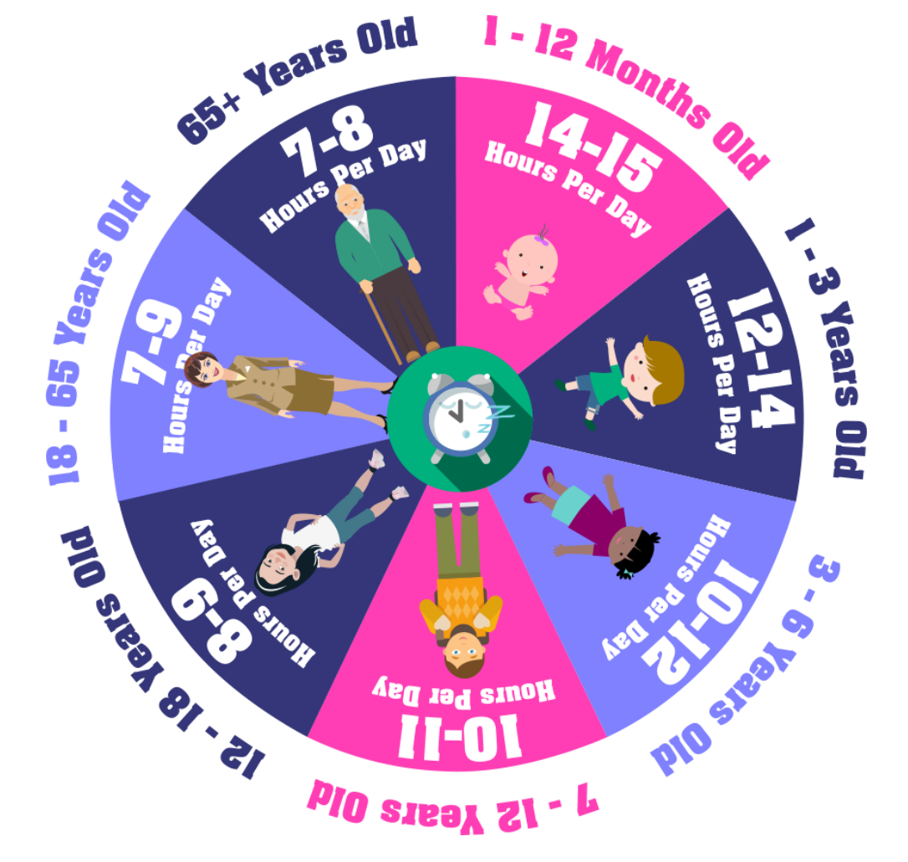
How much Sleep do we need?

Slide 7
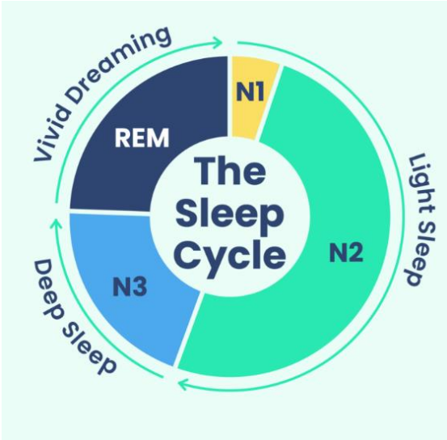
What are the stages of sleep?
There are 4 stages of sleep
A sleep cycle is approximately 90 mins
We have 4-6 sleep cycles per night
N1-Light sleep, Breathing and Heart rate slow
N2-Breathing & Heart slowdown further, muscles relax
N3-Deep Sleep, Restoration stage, Body repair, Brain waves slow down
REM- Rapid Eye Movement and Dreaming, increased Brain waves

Slide 8
How does lack of sleep affect children?
Effects on Mind and learning
Worsened memory, poor concentration, moodiness ,aggression, irritability, and making poor choices
Diet: Seep loss can make children crave sugary foods so it’s important to ensure a healthy, balanced diet
Physical Health: Lack of sleep can lead to decreased immunity and increased illness
Mental Health: Poorer regulation of emotions, tearfulness, and struggles with friendships and relationships

Slide 9
How are sleep and learning related?
Good sleep hygiene is needed for good learning
Our brains like a computer work on processing our thoughts and learning all the time by building our network of neurons and synapses in neural pathways in the brain
Sleep is needed and helps our memory and consolidation of new learning

Slide 10
Top Tips for a good night’s sleep?
A cool comfortable room
No distractions or screen for about an hour before bed
Have a small healthy snack and drink so hunger doesn’t interfere with sleep
Darkened room, comfortable bed not too hot or cold or too light
Read a book or do calming colouring or a story before bed

Slide 11
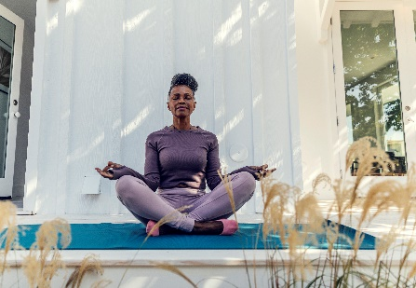
Mindfulness, Breathing, and Sleep?
Encourage calm breathing and mindfulness at bedtime
Mindfulness is about clearing the mind and focussing on the breath, it is about focussing on the present
Try sleepy 4,7,8 breathing- Inhale through the nose for 4 seconds, hold for 6 seconds and breath out for 8 seconds through the mouth. Children can be taught to do thisand is a good way to relax before sleeping

Slide 12
Gratitude and Sleep?
Encourage gratitude and reflection at bedtime
Ask your child to think of 3 things they are grateful for and you could both share the good things from the day
Benefits of gratitude before bed encourages good thoughts before bedtime and may help children settle more easily

Slide 13
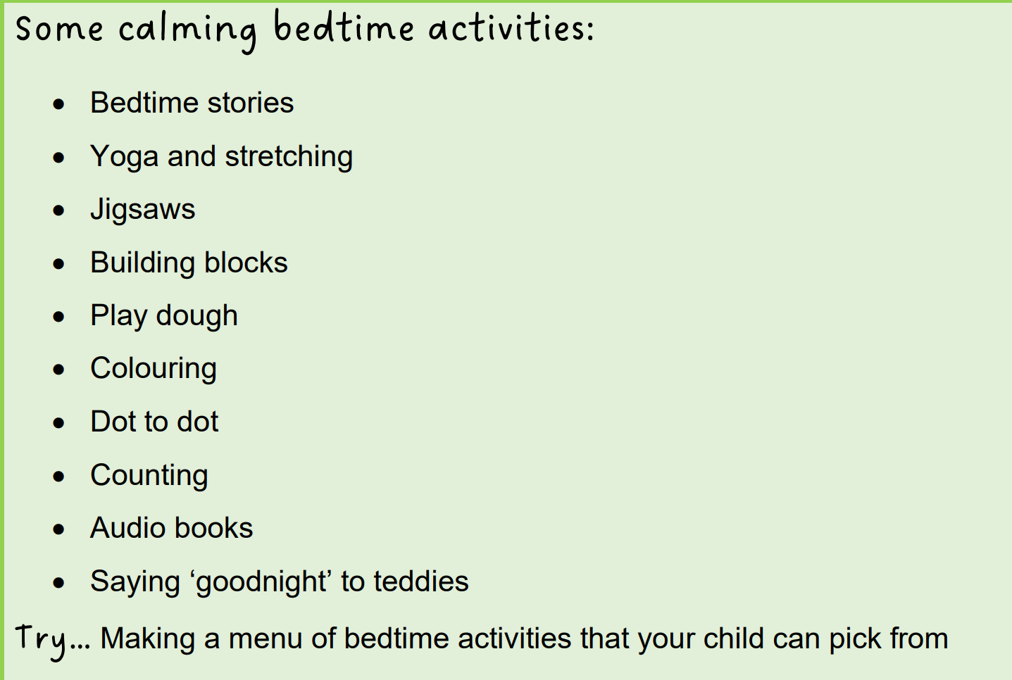
Calming Activities?

Slide 14
Common Sleep Problems?
Night Terrors- if these happen speak in a calming voice and guide them back to their own bed
Waking in the night- encourage to self soothe to get back to sleep
Worries- use the worry tree to help sort worries out and encourage calm
Monsters! If your child is scared of something help them investigate rather than dismiss their worry
Dependency on parent being there

Slide 15
Sleep Hygiene and sleep routine?
Aim to have correct amount of sleep-primary age is 10 Hours
Have a good set routine for your child that everyone putting your child to bed follows- CONSISTENCY is KEY!
Establish a relaxing routine eg, bath, bed, brush teeth, story, lights out etc
Calm music and a night light can often help
Encourage sleeping in their own bed

Slide 16
Sleep Hygiene and sleep routine?
Thank you for listening!
We will be around for a little while for any questions

Slide 17
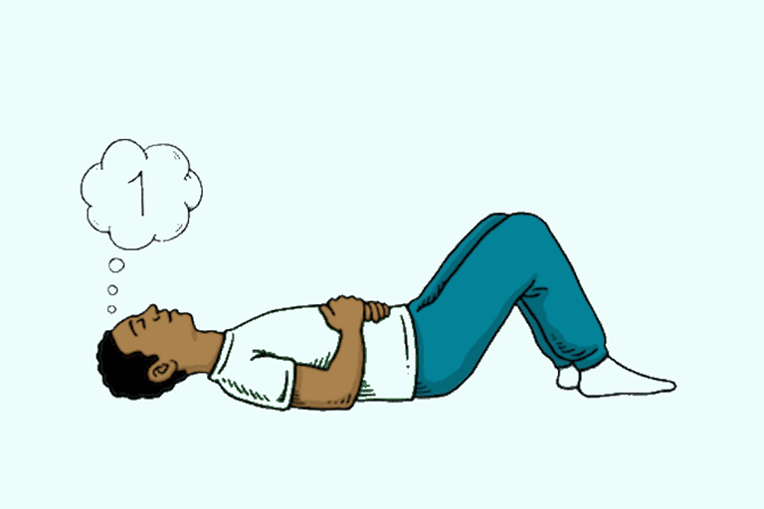
Mindful moment
Belly Breathing Activity
Notes:
Before we start, get the children to practice belly breathing – bringing a sense of calm.
Talk through belly breathing and get the children to do it along with you.
How did that feel? - breathing activities can help relax our whole body and relax our minds.

Slide 18
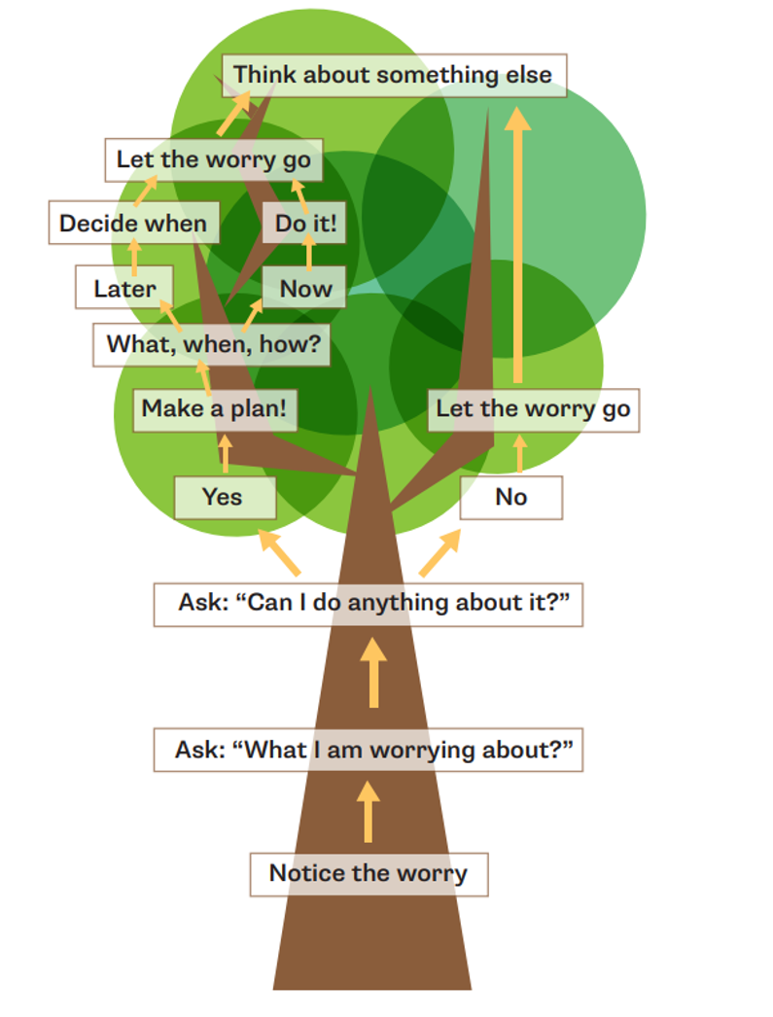
The Worry Tree
(1561) Worry Tree - YouTube
Notes:
Explain worry tree / play youtube video for the class.
Hand out worry tree to each table and get them to work through the worries they came up with on the post it notes earlier.
Bring the class back together and speak through some of these worries using the worry tree as a class

Slide 19
Mindfulness: Happy Place
https://youtu.be/8xLCFPgSudE?list=PLPO8A9eBJyWsizvD4NgPamGqKtKRBrAd1
If you
Notes:
Happy place mindfulness video – Close eyes and visualise

Slide 20
Find us online...
@rise.ne
Hope you enjoyed this session!
@rise_mhst
bit.ly/Rise-ne
Check out the RISE YouTube channel for more well-being videos!
rise.childrenssociety
.org.uk/

