Slide 1

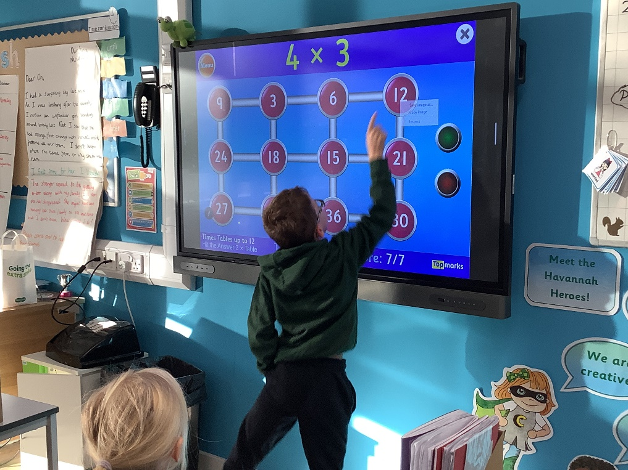
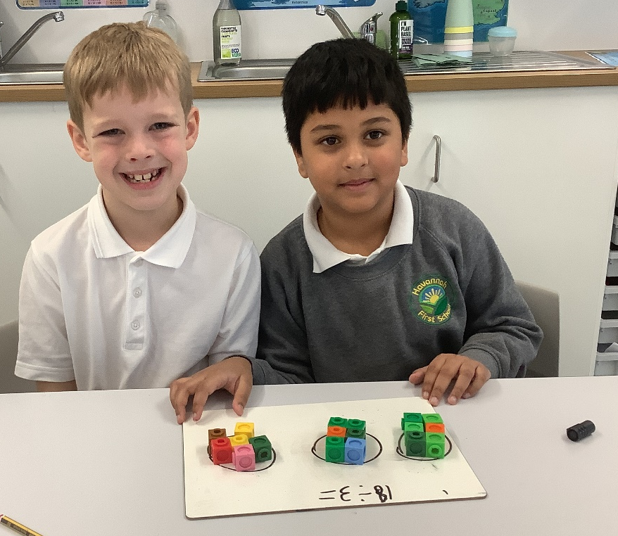
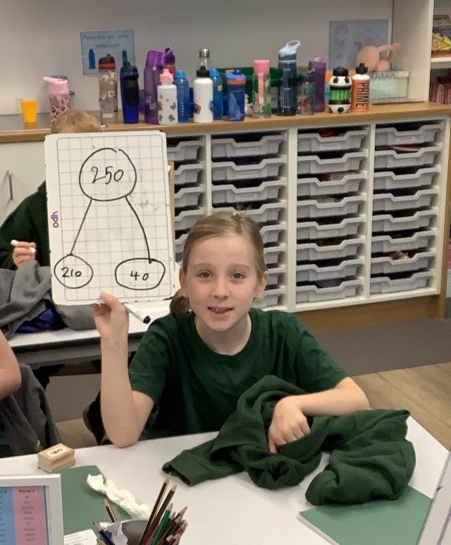
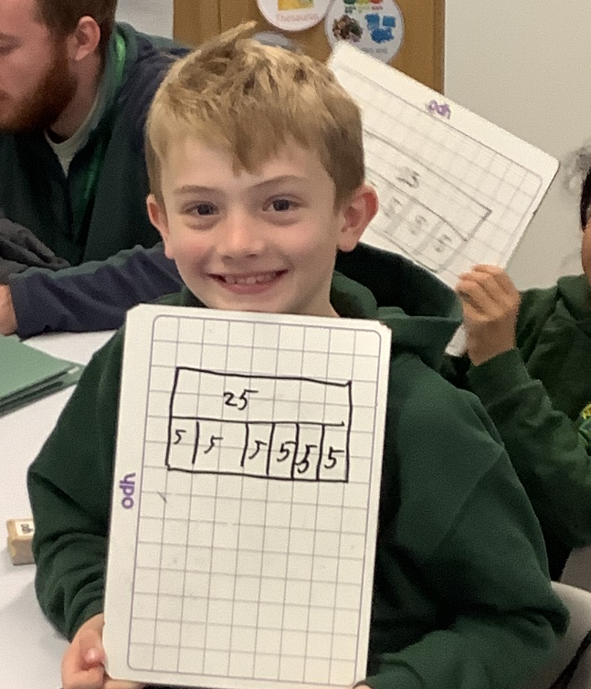
Maths at Havannah First School
Challenge, Equality & Opportunity

Slide 2
Mastery – What is it?
Mastery in Maths is being able to understand and apply knowledge to different contexts and situations.
It can also be explaining thought processes, as well as, proving and giving reasons for answers.
This approach aims to broaden children’s understanding of a concept, enabling them to use what they know in new situations.

Slide 3
Stages of Mastery
Fluency in Maths happens when children can answer questions accurately using recall of Mathematical facts.
Reasoning is when a child can explain what they have done and why, or prove that something is or isn’t correct.
Problem solving is applying their knowledge and understanding to multi-step problems.

Slide 4
Stages of Teaching
Maths learning should follow a process, moving through each stage when the child is ready.
If the child is moved too quickly through the concrete and pictorial stage of their learning, this could affect understanding in later years.
Concrete
Pictorial
Abstract

Slide 5
How Maths is taught at Havannah
In KS 1 and 2, Maths is taught 5 times in a week.
Schemes of learning are based on the White Rose Maths Schemes of Work and support our school’s mastery approach to teaching and learning and are consistent with the aims and objectives of the National Curriculum.
Number is at the heart of our schemes of learning and a significant amount of time is spent reinforcing number in order to build competency and allow and ensure children can confidently access the rest of the curriculum.
We aim for children to stay within the required Key Stage so that children acquire depth of knowledge in each topic.
Opportunities to re-visit previously learnt skills are built into planning.
Children can progress through schemes of learning as a whole group, encouraging children of all abilities to support each other in their learning.
The vast majority of children progress through the curriculum at a similar pace.
Questioning, marking and feedback of work helps to identify those children who need further support, provides opportunities to address misconceptions and also allows children to make corrections or complete next step challenges. This allows the vast majority of children to continue to work at a similar pace.

Slide 6
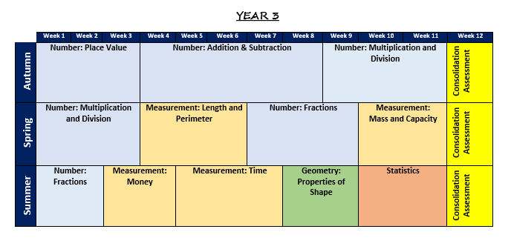
Long Term Plan for Maths

Slide 7
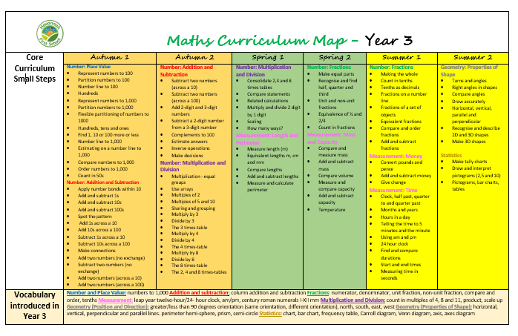
Small Steps in Maths

Slide 8
What does Maths Mastery look
like in our lessons?
We break the learning down into ‘thinkable’ chunks or small steps. We ensure that each step is mastered before moving on.
We revisit and build on previous learning, developing fluency.
We use representations and equipment to draw out mathematical understanding.
We provide opportunities to reason and make connections – this helps pupils to remember.
We include all learners.

Slide 9
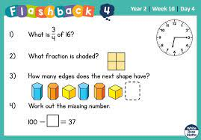
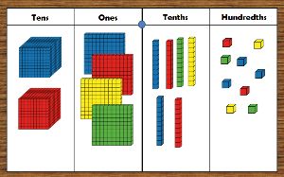
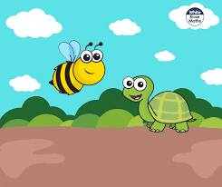
A typical Maths lesson at Havannah First School
Each KS1 and 2 lesson typically follows the following format:
Flashback 4 (Daily retrieval – questions based on last lesson, last week, two weeks ago and further back)
A starter activity – practice skills needed for main activity and an introduction to key vocabulary.
A talk activity – what do the children know. Building on previous knowledge.
An open questioning task - to engage all learners (discussion of strategies)
A misconception question – a question that shows a common misconception related to the small step.
A range of questions which encourages reasoning/strategies – e.g. How do you know? What’s the same and what’s different, missing lengths or representations, True or False etc…
Independent Practice – Fluency/Reasoning and Problem Solving questions in book.
Recap of lesson/Self marking and discussions.
Maths Blast (KS2) - Fast recall (retrieval) of previous term’s content (knowledge and skills).

Slide 10
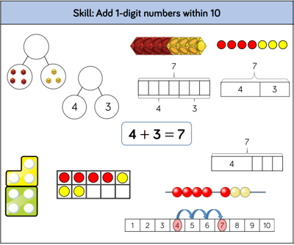
Example of Year 1 – teaching strategies for adding 1-digit numbers within 10

Slide 11
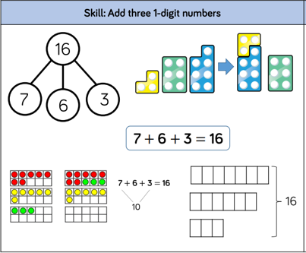
Example of Year 2 – teaching strategies for adding three 1-digit numbers

Slide 12
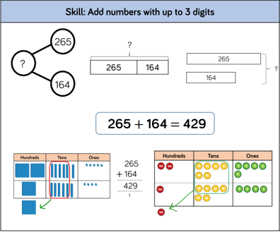
Example of Year 3 – add numbers with up to 3 digits

Slide 13
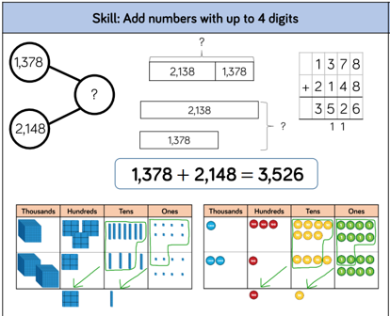
Example of Year 4 – add numbers with up to 4 digits

Slide 14
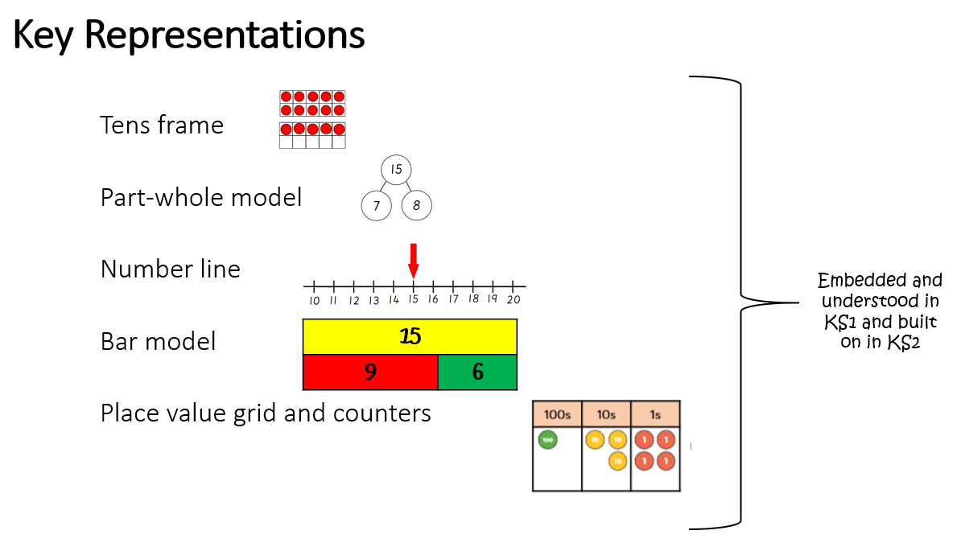

Slide 15
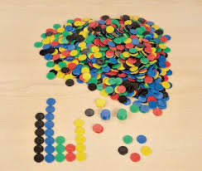
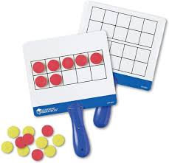
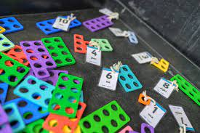
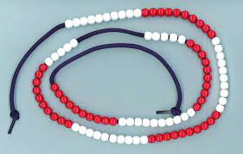
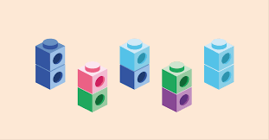
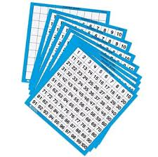
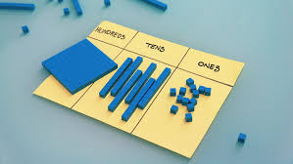
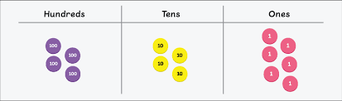
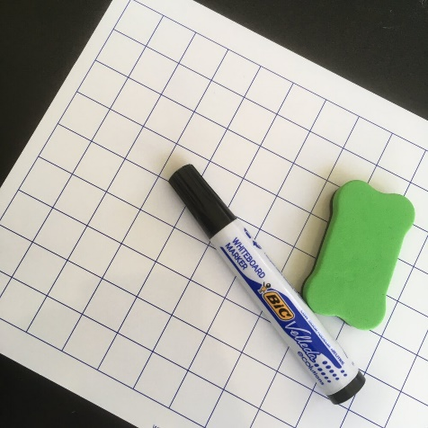
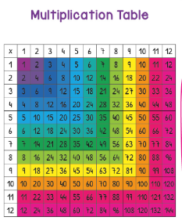
Manipulatives we use in school to aid our learning

Slide 16

Helping your child at home…
Have a positive mindset about Maths!
Use maths talk everyday – two easy concepts to develop with your children are doubling/halving and adding/subtracting. Again, you could use physical objects such as food to reinforce this. It’s as simple as asking your child to count the number of chicken nuggets or peas (or any other food!) on their plate at dinner time. and then you can ask them things like:
“If I doubled the number of chicken nuggets on your plate right now, how many would you have?”
“If I ate half the peas on your plate for you, how many would you have left?”
“If we added all of my chicken nuggets to your chicken nuggets, how many would we have altogether?”
Point out the Maths is all around us in everyday life. Include your child in activities involving numbers and measuring, such as shopping, cooking and travelling – telling the time, managing money etc...
Games are a great way to bond with your children, but also many games use mathematical and logical skills that your children will need in later life. Even a simple jigsaw puzzle helps children to develop logical and spatial awareness skills. Furthermore, games like snakes and ladders enable children to count the rolls of the dice, which helps develop their counting skills
When you look around, everything is made out of shapes. So why not encourage your children to learn the names of shapes when you’re out and about to entertain them? They could identify car wheels as circles, windows as rectangles and even tiles as hexagons or whatever shape they may be!

Slide 17

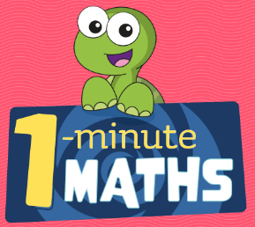

Encourage your child to use the computer for educational purposes – have a look on our school website for suggested websites to visit.
Find out more about our work on the school website or at : www.whiterosemaths.com
Download the White Rose ‘1-Minute Maths’ app
– great for fluency in number facts and FREE.
As everybody knows, it’s essential for children to learn their times tables in order to access harder maths questions. This is an easy thing for parents to practise with their children - sneak it in when they’re bored! Make car journeys go by faster, or distract them on the bus by asking times tables questions. Challenge them to say their times tables backwards if they get bored of reciting them.
Access Times Tables Rockstars in Years 3 and 4
If you find that your child needs to challenge themselves more, or gets bored easily. Explore websites such as NRICH (http:// nrich.maths.org/) or Transum (http://www.transum.org/).

Slide 18
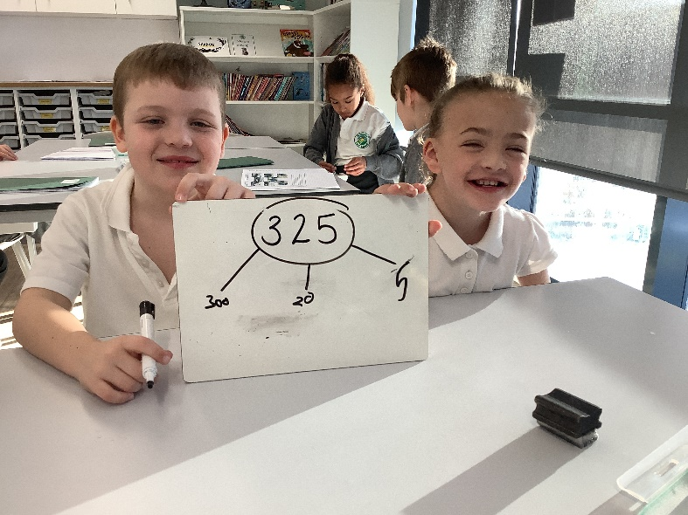
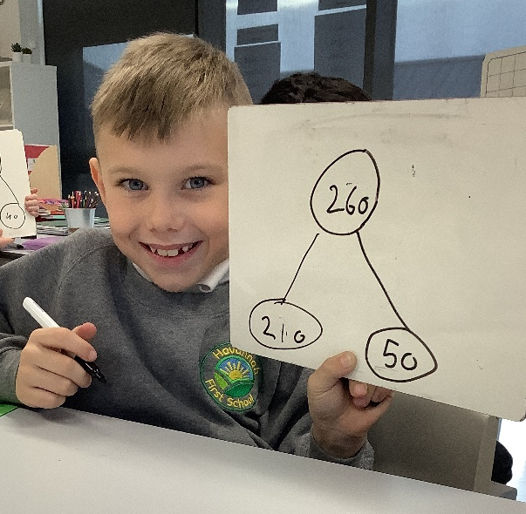
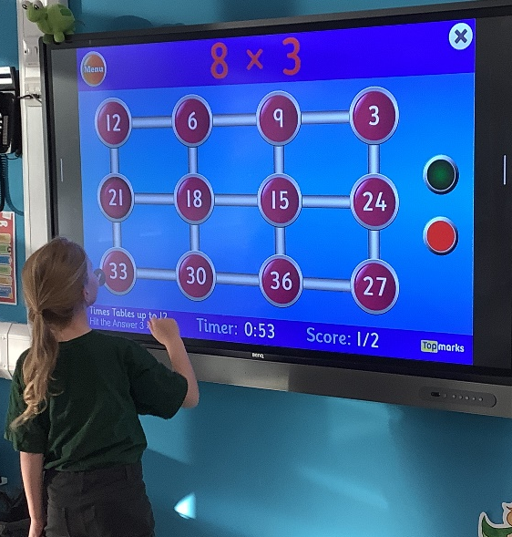
Thank you for attending – if you have any questions then please do get in touch with the class teacher, Mr Burnett, our Maths Lead or visit the curriculum section on our website and follow the links to maths.

