Slide 1
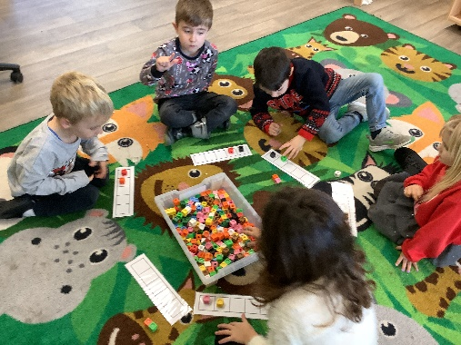
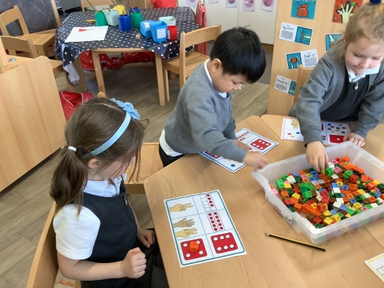
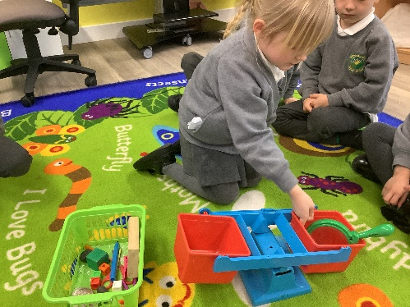
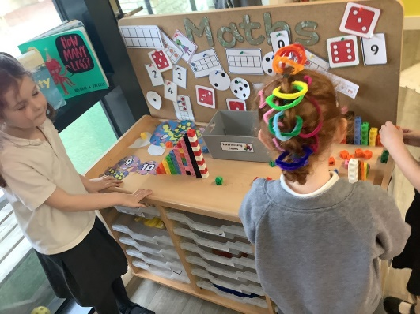
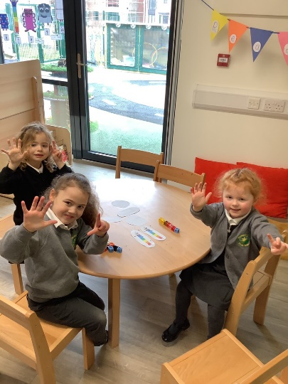
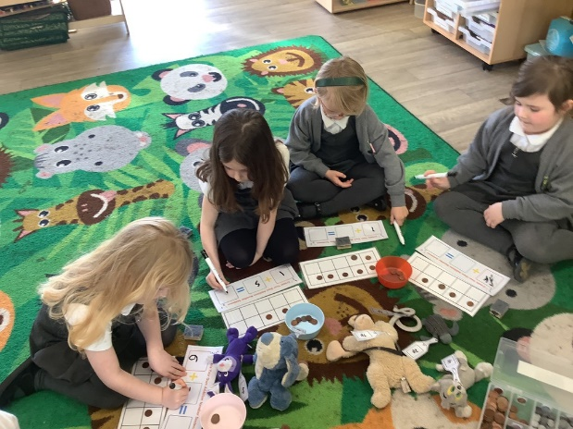
Reception Maths Parent Workshop

Slide 2
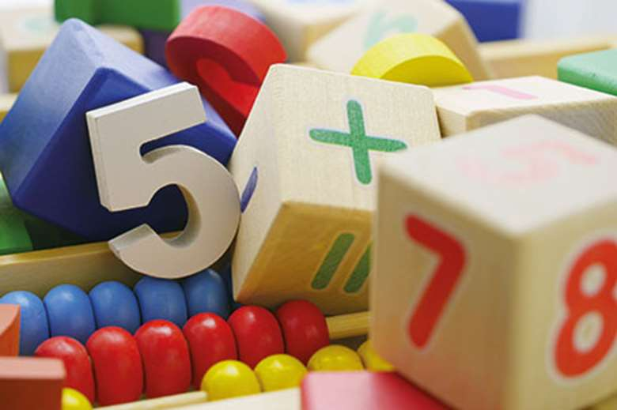
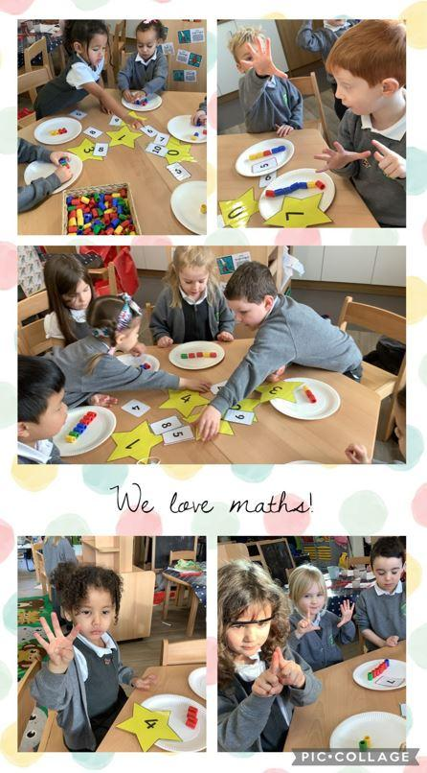
Maths in Reception
The first few years of a child’s life are especially important for mathematics development.
The objective for those working in Early Years, then, is to ensure that all children develop firm mathematical foundations in a way that is engaging, and appropriate for their age.
Children’s chances of success are maximised if they develop deep and lasting understanding of mathematical procedures and concepts.

Slide 3
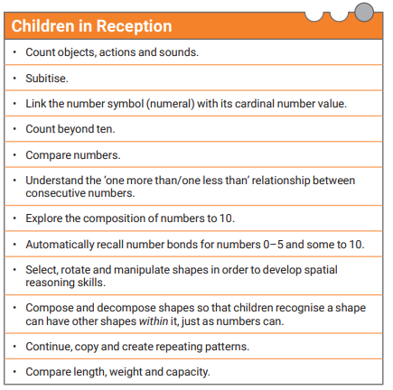
EYFS Maths Statements

Slide 4
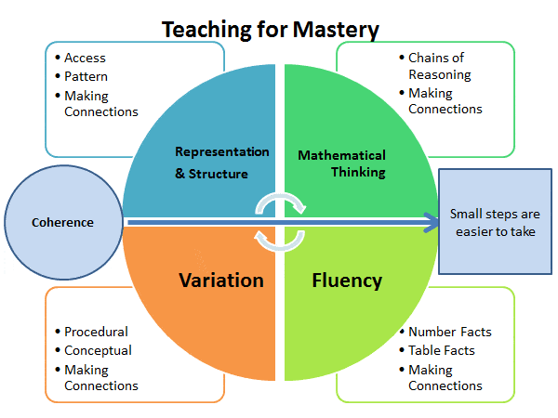
What is Maths Mastery?
Maths Mastery … Mastering maths means pupils of all ages acquiring a deep, long-term, secure and adaptable understanding of the subject.
Notes:
Jane

Slide 5
White Rose Maths
A scheme of learning is a clear, time-linked plan for learning.
White Rose schemes are written for year groups and cover the whole school year of learning.
The scheme is divided into ten key phases and provides a variety of opportunities to develop their understanding of number, shape, measure, and spatial thinking.
In Early Years there is a strong focus on early number. Children need a really strong sense of numbers to 10.
This includes:
Understanding the link between numbers and quantity (representing in different ways)
Investigating how quantities are composed of smaller parts (6 can be two 3s or three 2s or 4 and two 1s)
Knowing how numbers relate to one another and being able to compare and order them
Exploring how quantities change when you add more items or take items away
Children may already be able to recite the number names to twenty and beyond but a sense of what those numbers mean develops gradually with repeated experiences in different contexts.
Notes:
Jane

Slide 6
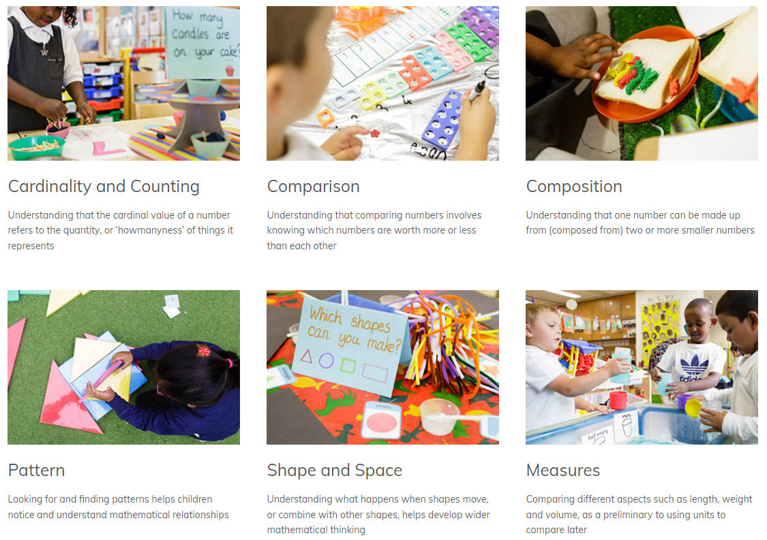
There are six key areas of early mathematics learning, which collectively provide a platform for everything children will encounter as they progress through their maths learning at primary school, and beyond.

Slide 7
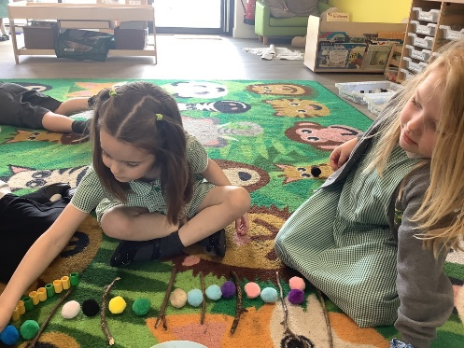
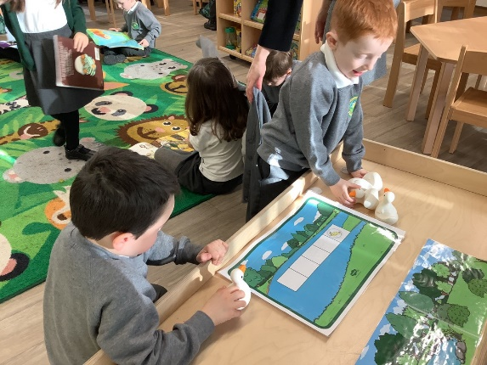
Teaching to develop:
Fluency
Reasoning
Problem Solving
A love of maths!

Slide 8
What is fluency?
Fluency is the ability to quickly recall addition, subtraction, multiplication, and division maths facts through conceptual learning, fact strategies, and memorisation.
We often refer to the skill of subitising when developing fluency.

Slide 9
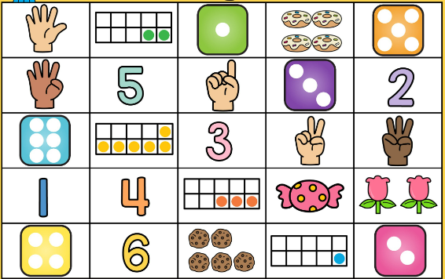
Subitising
In order for children to develop fluency and calculate successfully and quickly, children need to be able to ‘subitise’ well.
This means they need to be able to recognise how many spots there are on dice, dominoes and Numicon etc. instantly without counting them.
Eventually, the children will imagine these images in their head, helping them to calculate.

Slide 10
What is reasoning?
Reasoning in maths is the children’s ability to explain their thinking.
Children often work in mixed ability groups and partnerships to enable them to have lots of practice with this.
Other examples of teaching ‘reasoning’ in whole class sessions or play are spotting mistakes and explaining true of false statements.

Slide 11
What is problem solving?
Problem solving allows children to use their maths skills in lots of contexts and in situations that are new to them.
It allows them to seek solutions, spot patterns and think about the best way to do things rather than blindly following maths procedures
Notes:
Jane

Slide 12
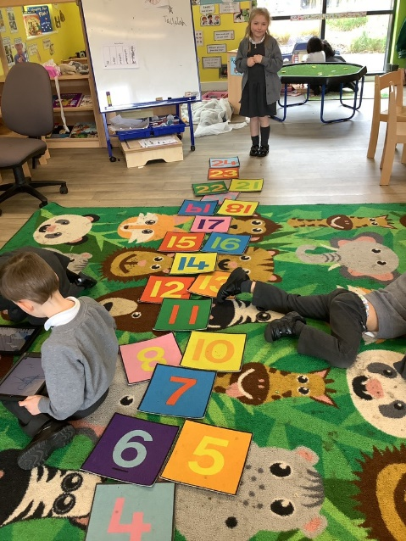
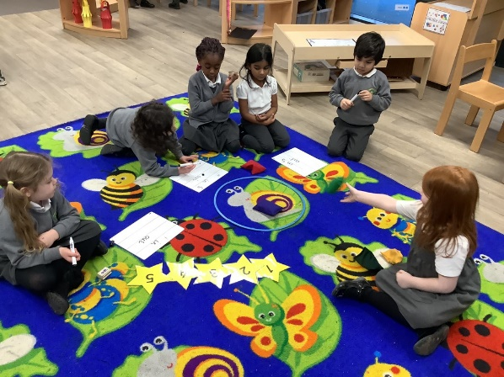
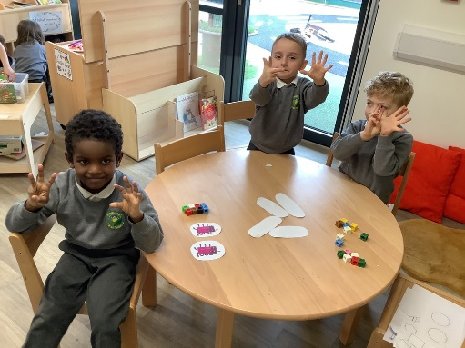
How we teach Maths in Reception
Maths happens both indoors and outdoors through a wide range of practical activities using lots of concrete resources.
Children are taught in a whole class carpet session focused on a particular area of their learning.
Children then have the opportunity to practise those skills and choose from different indoor and outdoor activities all based around the skill they have just learnt.
Child initiated play.
Adult led group tasks.

Slide 13
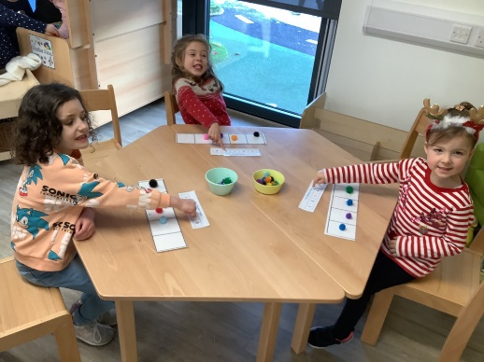
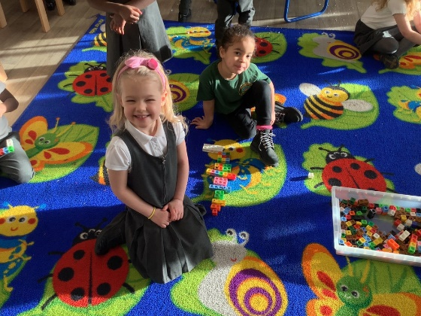
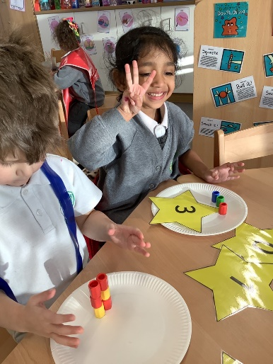
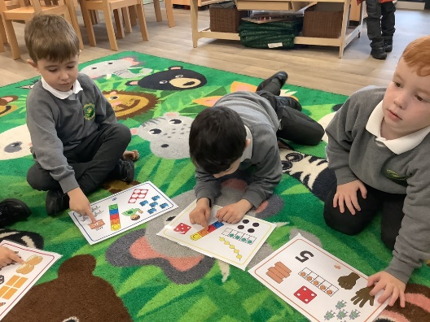
Ways in which maths may be taught in Reception
Through Songs –
“1,2,3,4,5
Once I caught a fish alive”.
Talk about counting on, altogether, one more etc
Matching numbers to objects up to 20
Illustrate number stories with number sentences
Representing numbers e.g. making marks or using their fingers
Counting on fingers in a consistent way

Slide 14
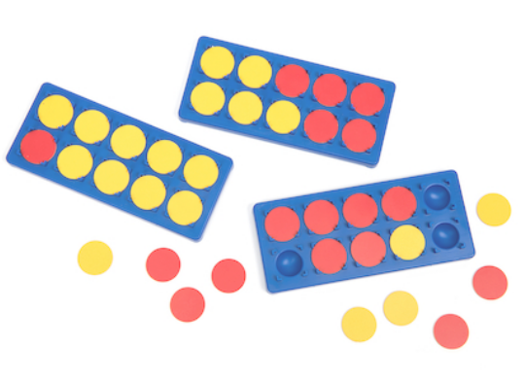
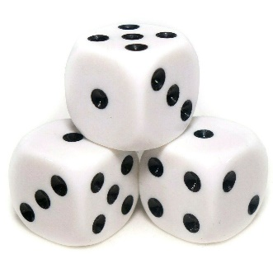
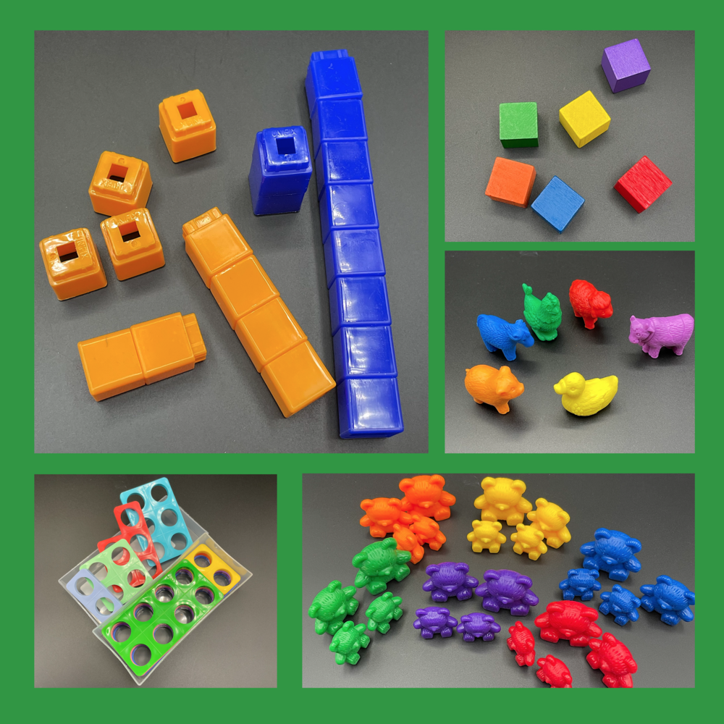
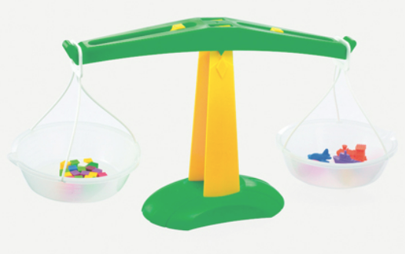
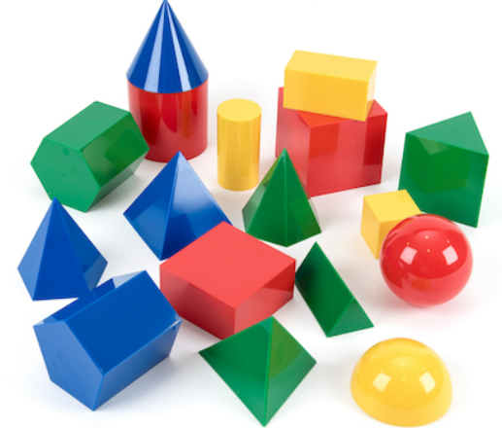
Maths Resources

Slide 15
Number Vocabulary
zero
compare
more
few
fewer
less
more
most
the same
number
sort
pair
ones
count on
count backwards
order
before
after
Notes:
Jane

Slide 16
Addition and Subtraction Vocabulary
add
altogether
one more
one less
more
takeaway
equals
equal to
whole
parts
How many?
make
numberline
total
half
double
Notes:
jane

Slide 17
Measure
Before
After
Next
Last
Now
Soon
coin
buy
sell
pay,
price
how many?
tall
small
large
thick thin
low deep
Days of the week
Months
Year
Long
Longer
longest
short
shorter
shortest
yesterday
tomorrow
old
new
capacity
weekend
holiday
empty
full
nearly empty
weight, weigh, weighs
late
quick
fast
slow
heavy, heavier, heaviest
light, lighter, lightest
morning, afternoon,evening, night
Notes:
Jane

Slide 18
Multiplication and Division
once, twice
Sharing, share
times
set
group
Counting in…
groups of
left
left over
lots of
Notes:
Jane

Slide 19
Geometry – Position and Direction
In, inside
On, on top of
Under
Behind
Next to
Above
Below
after, before
across
close
far
along
distance
forwards
backwards
position
outside
around
underneath
in front
slide
roll
turn
stretch
bend
move
top
bottom
middle
Notes:
Jane

Slide 20
Geometry – Shape
round
flat
straight
build
draw
Square
Circle
triangle
sort
cube
cuboid
sphere
shape
slide
roll
turn
stretch
bend
move
Notes:
Jane

Slide 21
End of year expectations for Reception
Maths Early Learning Goals:
This is the knowledge, skills and understanding children should have at the end of the academic year in which they turn five. Teacher make a holistic, best-fit judgement about a child’s development, and their readiness for year 1.

Slide 22
ELG: Number
Children at the expected level of development will:
Have a deep understanding of number to 10, including the composition of each number;
Subitise (recognise quantities without counting) up to 5;
Automatically recall (without reference to rhymes, counting or other aids) number bonds up to 5 (including subtraction facts) and some number bonds to 10, including double facts.

Slide 23
ELG: Numerical Patterns
Children at the expected level of development will:
Verbally count beyond 20, recognising the pattern of the counting system;
Compare quantities up to 10 in different contexts, recognising when one quantity is greater than, less than or the same as the other quantity;
Explore and represent patterns within numbers up to 10, including evens and odds, double facts and how quantities can be distributed equally.

Slide 24
What can you do at home?
Point out where Maths exists in real life to support children with mathematical language and to help their understanding.
What shapes can they see?
Which size saucepans do we need for cooking?
When walking past houses on the way home from school, what is happening to the door numbers? Are they getting bigger or smaller?
How much pizza has been eaten?
Count the pairs of socks on the washing line.
Measuring themselves.
Allow them to play in the bath with different sized containers.
Let children make up their own games and decide how to score points
Counting objects can be made from Lego, small figures, rubber ducks, buttons, coins
Building blocks are great for talking about measurement, the difference between 2 numbers, adding blocks etc.
Their fingers! Encourage them to count on and count back, add and subtract using their fingers.
Ask questions such as “How many more?”, “How many altogether?”, “How many would I have if?”
Deliberately make mistakes
Story books- Look for the Maths!

