Slide 1








Find us online...
@rise.ne
Emotions and Co-regulation: Parent workshop
@rise_mhst
http://youtube.com/@rise-ne
rise.childrenssociety
.org.uk/
Notes:
​

Slide 2
Who are we?
We are Education Mental Health Practitioners (EMHPs for short).
It’s our job to help children and young people learn how to improve and maintain their mental health using an evidence-based CBT approach.
https://rise.childrenssociety.org.uk/
Notes:
Rachel

Slide 3
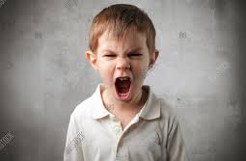
How Rise support emotion regulation:
Psychoeducation: Teaching children about their brain and emotions (Fight, flight or freeze) and how emotions feel in their body.
Noticing and naming emotions. We learn that how we breathe, move, and what we focus our attention on can change how we feel. We learn skills to help with this.
Zones of regulation and helping to get our energy right for the situation we’re in.
We also focus on thoughts. We learn that we can change how we feel and behave by noticing the thoughts that are making us feel worse and trying to change them. We learn that different people have different thoughts. We learn how to use positive self-talk to help our emotions.
Calming strategies: We show children how to calm their bodies when they are feeling big emotions so they can think more clearly.
Notes:
jenny

Slide 4
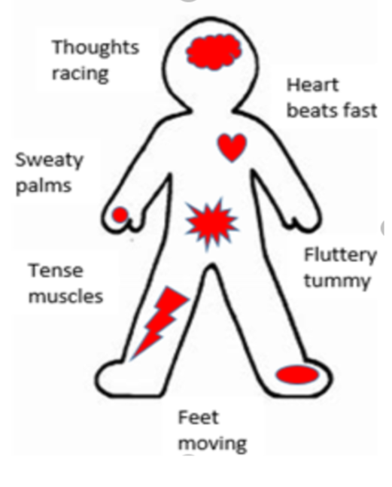
Fight, flight, freeze
Notes:
Jenny Do parent experiment – going to ask someone to come up and do a task or sing a song

Slide 5
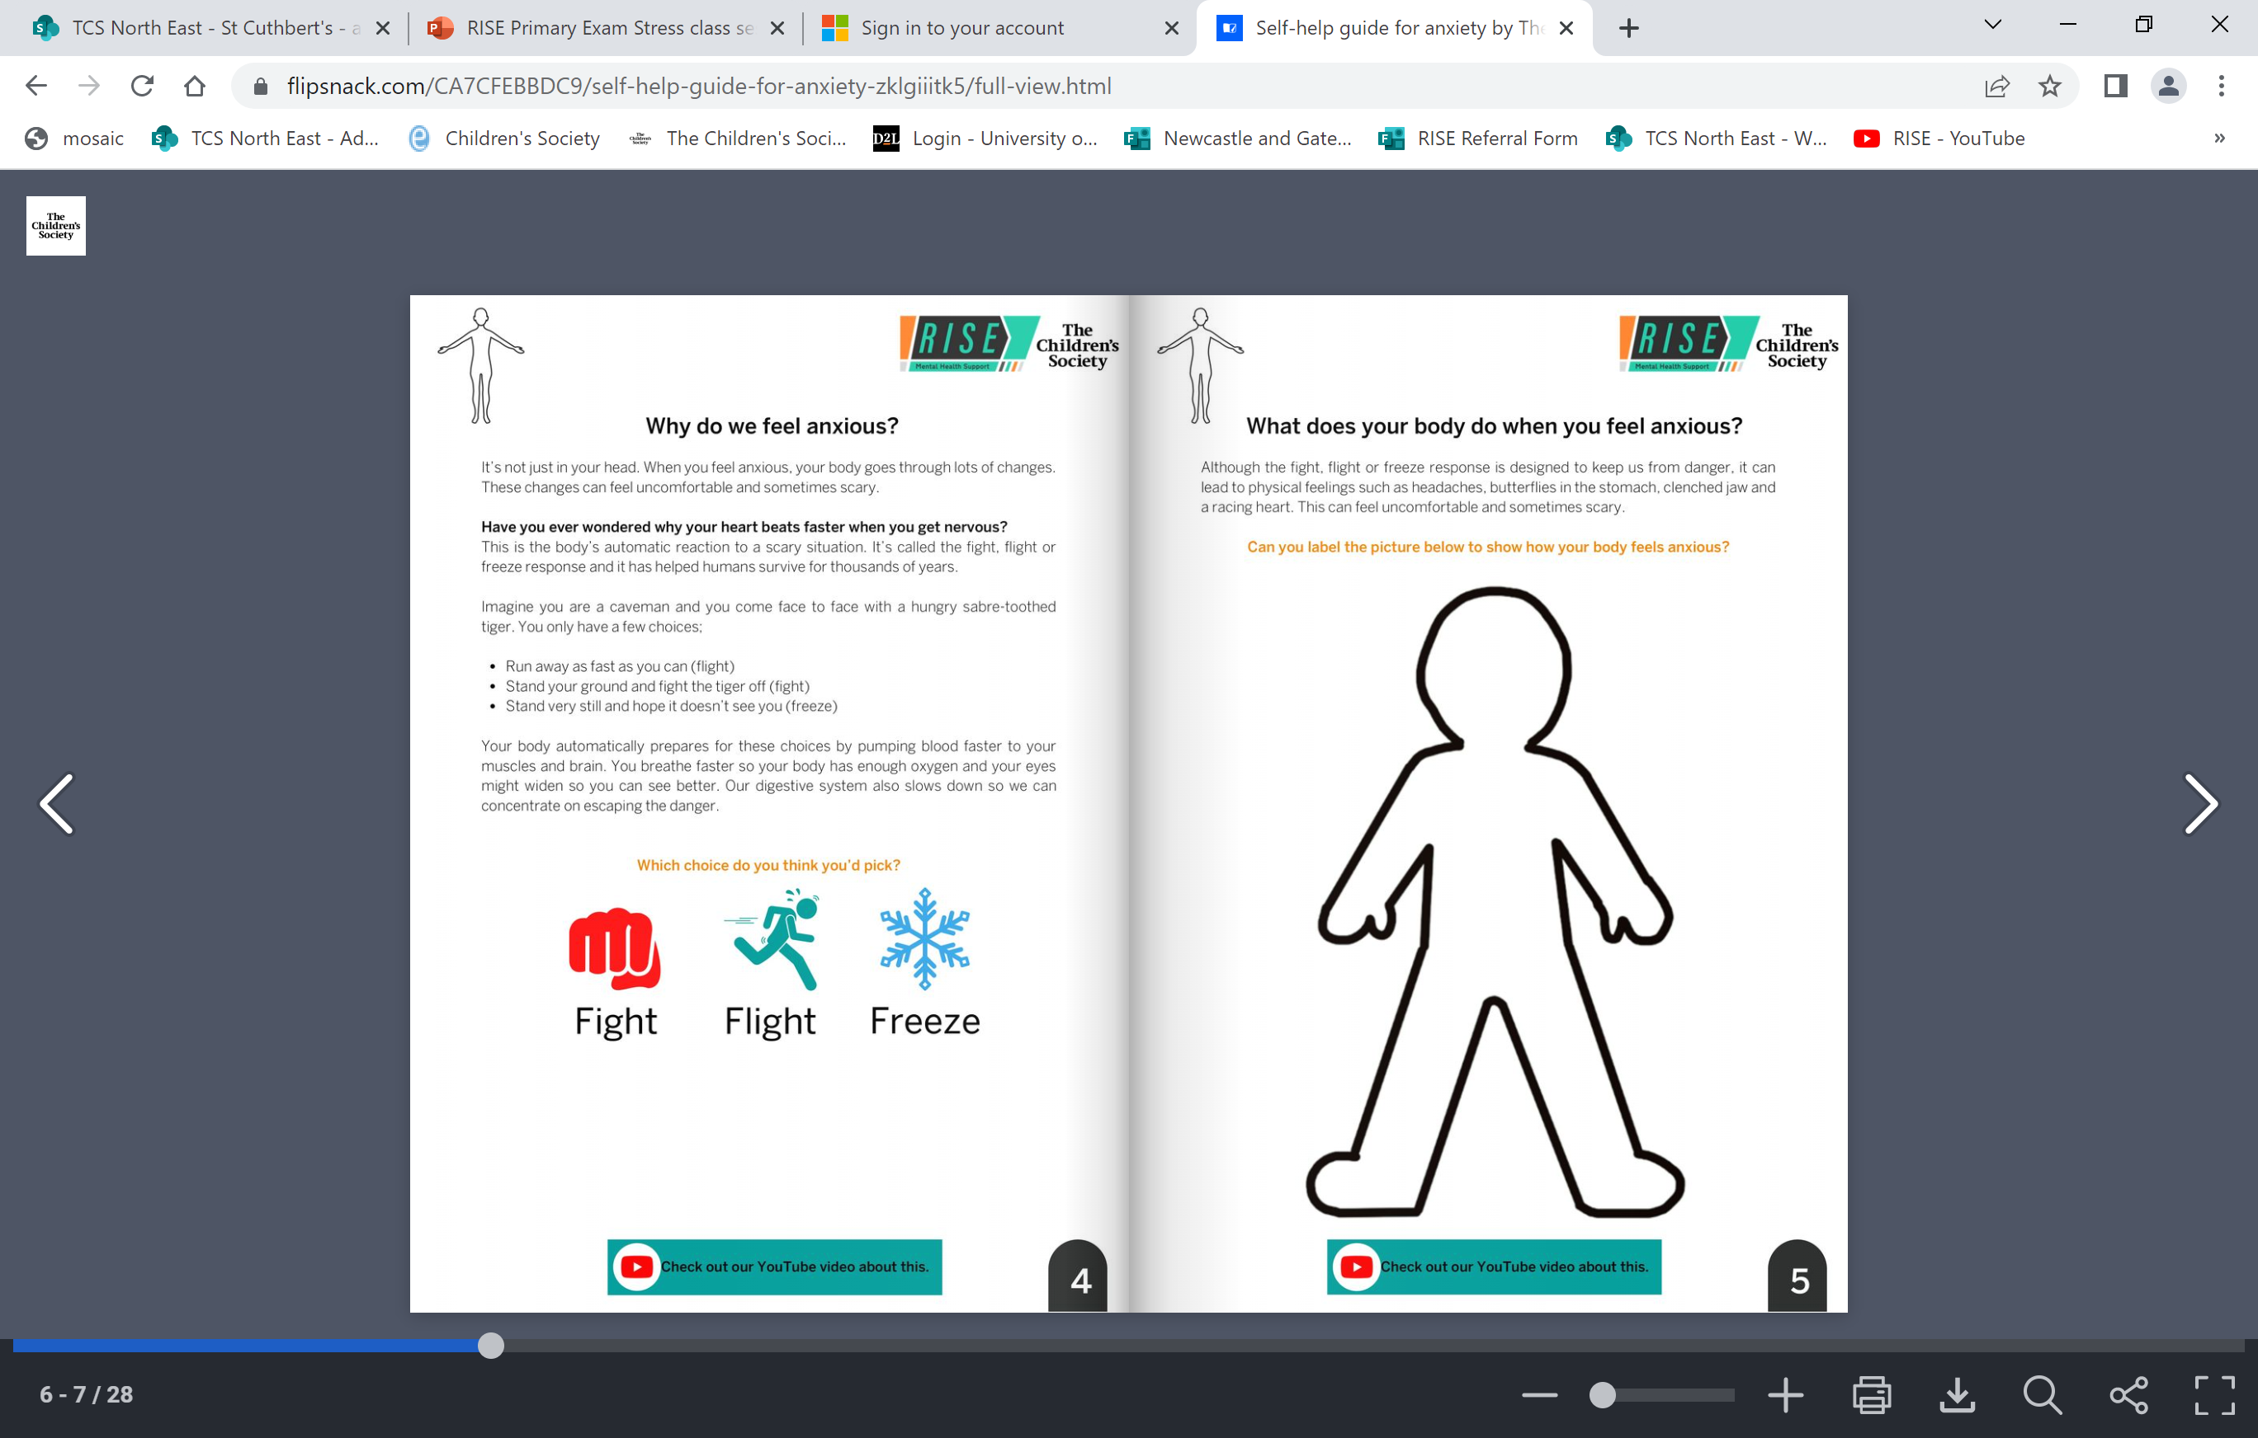
Kicking
Screaming
Pushing
Spitting
Throwing objects
Clenched fists
Struggled to breathe
Darting eyes
Restlessness
Excessive fidgeting
Doing anything to get away
Running away without concern for own safety
Holding their breath
Increased heart rate
Shutting down
Feeling unable to move – stuck
Escaping their own mind
Daydreaming
Complaining or asking lots of questions
Notes:
jenny

Slide 6
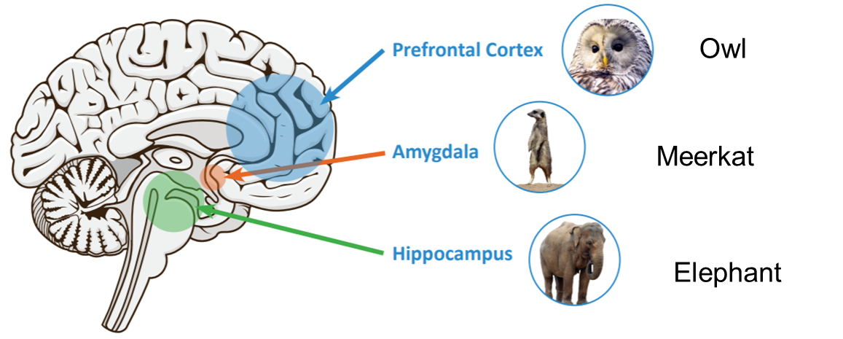
Why does our body go into Fight, Flight, Freeze?
Notes:
Jenny

Slide 7
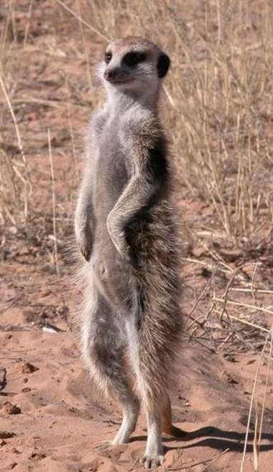
Amygdala - Meerkat
This is the first part of your brain to develop.
It’s job to is to keep us safe by looking out for potential threats and danger.
Our Meerkat can get confused and be like an oversensitive car alarm, telling us we are in danger when we are really not.
Every time the Meerkat thinks we are in danger it switches on Fight Flight Freeze.
Notes:
jenny

Slide 8
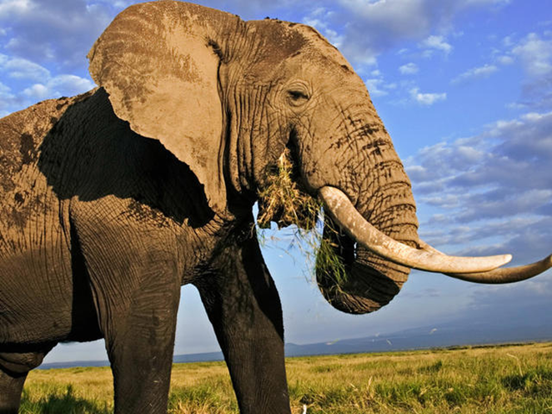
Elephant - Hippocampus
If situations remind us of a time we felt worried before, the meerkat tells our body to go into the fight, flight, freeze response – this is why we can feel anxious going into similar situations.
Its job is to remember the things you have done and how you felt doing them.
The elephant shares lots of memories with the meerkat.
Notes:
jenny

Slide 9
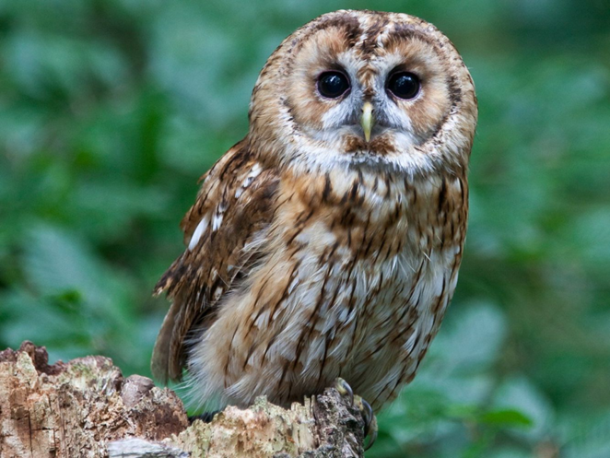
Owl – pre-frontal cortex
This is the last part of the brain to develop.
It’s job is to help with logic, reasoning and problem solving. These are all used to help us work out if we are in actual danger.
But this part of the brain is not fully developed in males till their 30s and females in mid-late 20s.
The owl can calm down the meerkat and the elephant and help calm us down and take us out of the fff response.
Notes:
Jenny This is the pre-frontal cortex and is one of the last parts of your brain to develop.
It’s job is to help us with our logic, reasoning and problem solving which can all be used to work out if we actually in danger.
The Owl can calm down the Meerkat and Elephant and help turn of the Fight Flight Freeze response.
However, the Owl doesn’t finish growing until your in your 30’s in males or your 20’s in females.
This is why children and young people need adults to help them with their worries and anxiety.
SARAH

Slide 10
Noticing and naming emotions:
What are Emotions For?
To help us…
Notes:
Jenny Encouraging emotional literacy by helping children to name the feeling they are having rather than focus on what they’re doing. Important message is that all emotions are normal and okay and they are there to help us, and some children need extra help with how they express them e.g. behaviour. “It’s okay to feel angry, but it’s not okay to throw”

Slide 11
We can group our emotions into 4 different zones
by how alert we feel when they are around
Blue Zone
Low state of alertness
Feelings: sad, tired, sick, bored
Body & brain moving slowly and sluggishly
Green Zone
Regulated state of alertness
I am in control and able to focus
Feelings: calm, happy, focused, content
I can do my work and be social
Yellow Zone
Heightened state of alertness but I still have some control
Feelings: stressed, frustrated, anxious, excited, silliness, nervousness, confusion, wiggly, squirmy, crabby, annoyed, overwhelmed, scared, jealous, upset, uncomfortable, embarrassed.
I am starting to lose control.
Red Zone
Extremely heightened state of alertness or very intense feelings
Feelings: Anger, rage, explosive behaviour, panic, terror, and feeling elated
Not feeling in control.
There’s a poor connection between my Thinking brain and Survival Brain
My thinking and Survival brain are working well together
Warning! I’m at risk of flipping my lid soon! I’m losing control
.
I’ve flipped my lid’
My thinking brain is ‘off line’
My survival brain guard dog has taken over.
Notes:
Jenny This can also be shown using a speedometer going from let blue – slow to red – extremely fast.
Using the different colours above can your circle which emotions you think belong in the different zones?
Can you group some of the emotions that you have thought of? Does everyone agree? It can depend on strength of the emotion that can differ – we zone through strength
Using an emoji pack – can you sort the emojis/ characters into the zones you think you should go by what emotion you think they are feeling.
Can you think of any of your favourite characters that may belong in different zones?
The Blue Zone is used to describe low states of alertness, such as when one feels sad, tired, sick, or bored. This is when one’s body and or brain is moving slowly or sluggishly.
The Green Zone is used to describe a regulated state of alertness. A person may be described as calm, happy, focused or content when in the Green Zone. This is the zone students generally need to be in for schoolwork and for being social. Being in the Green Zone shows control.
When you are in the green Zone which part of your brain do you think is in charge? Your wise owl thinking brain or guard dog survival brain?
The Yellow Zone is also used to describe a heightened state of alertness; how ever a person has some control when in the Yellow Zone. A person may be experiencing stress, frustration, anxiety, excitement, silliness, nervousness, confusion and many more slightly elevated emotions and states when in the Yellow Zone (such as wiggly, squirmy or sensory seeking). The Yellow Zone is starting to lose some control.

Slide 12
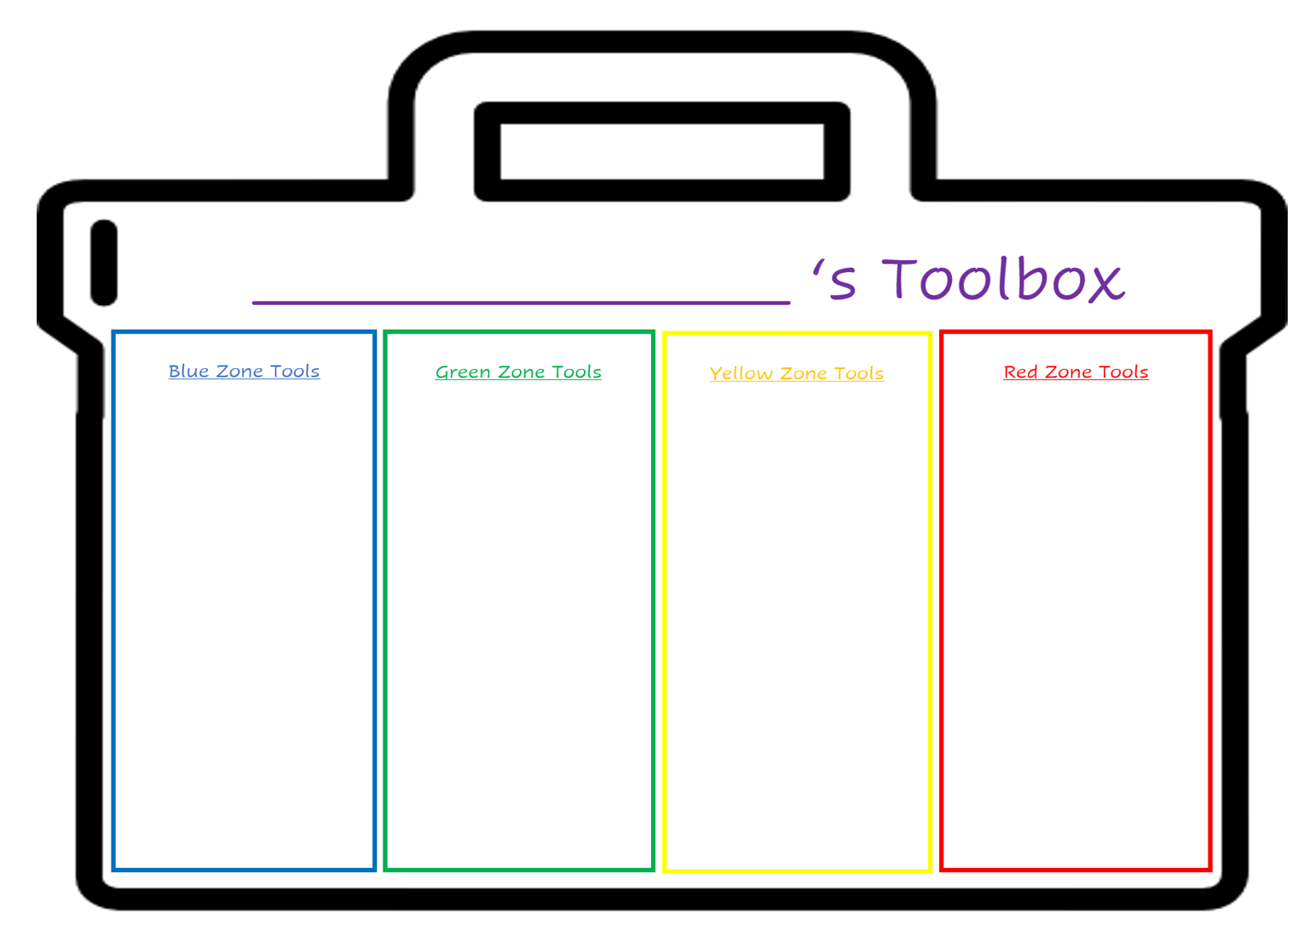
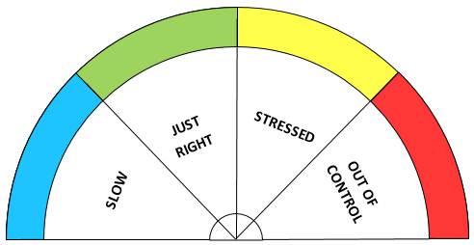
Making a Zones tool kit
Deep breaths
Jump on the spot
Think of my happy place
Walk away
Go to a quiet place
Push against a wall
Give myself an arm massage
Tell someone how I feel
Enjoy the moment!
Stretch it out
We can do different things to give us more energy or to release our energy.
To help us feel more alert and move up or to feel less alert and move down.
Notes:
Jenny Can make this as interactive as you like – can have different strategies printed out on tables and chn can try them and group them as to what they feel would be ‘alerting’ or ‘calming’ and ‘relaxing’ alerting strategies will energise and speed up heart rate – ask chn when they think this could be helpful

Slide 13
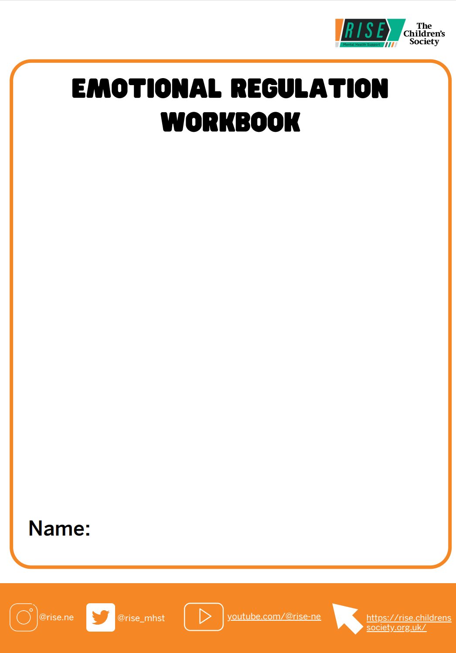
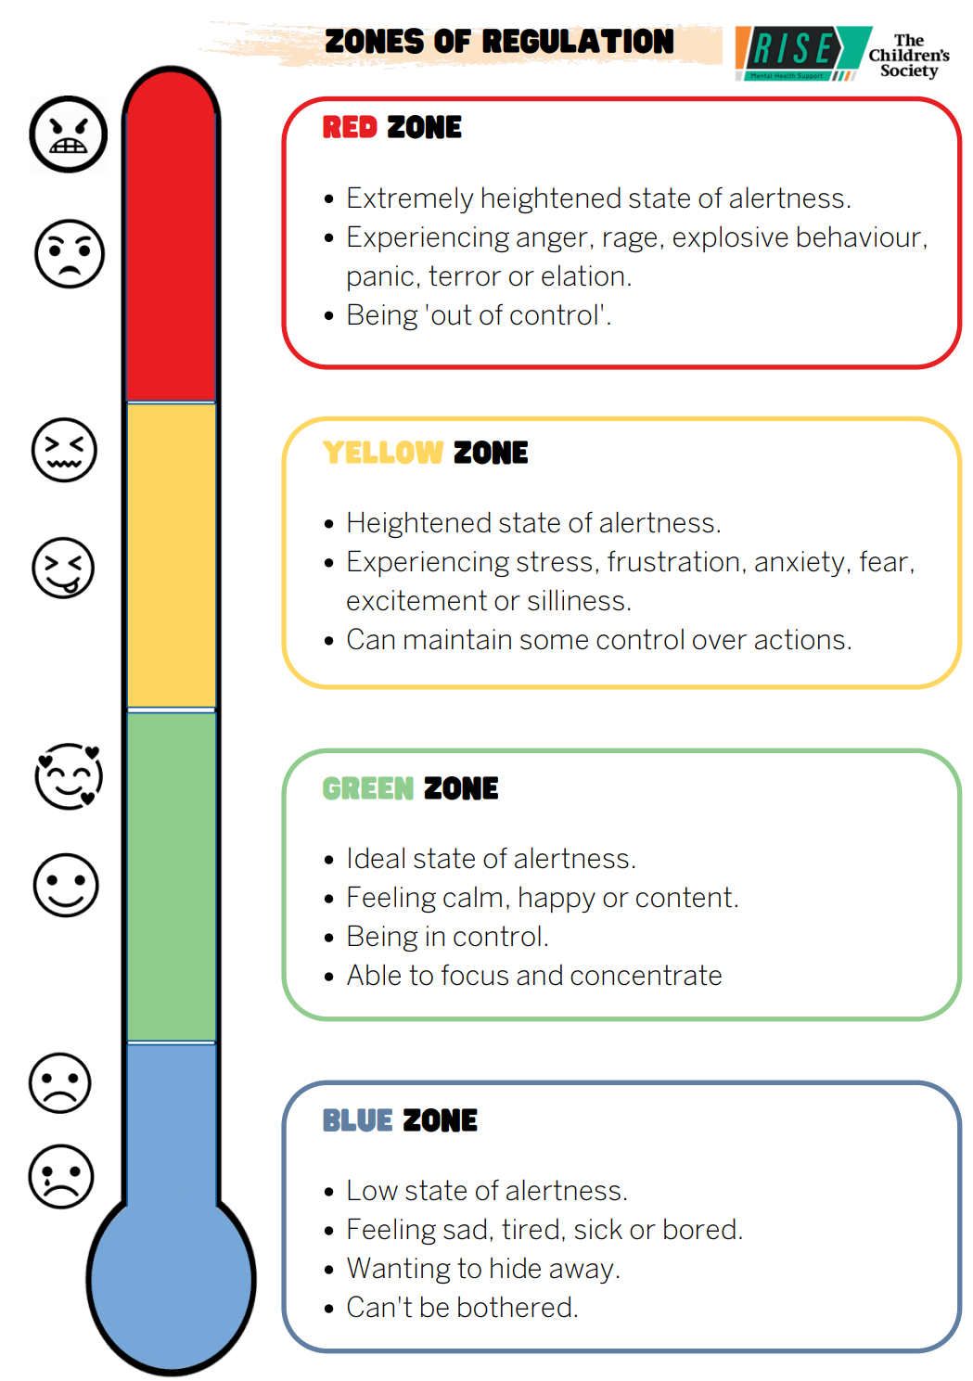
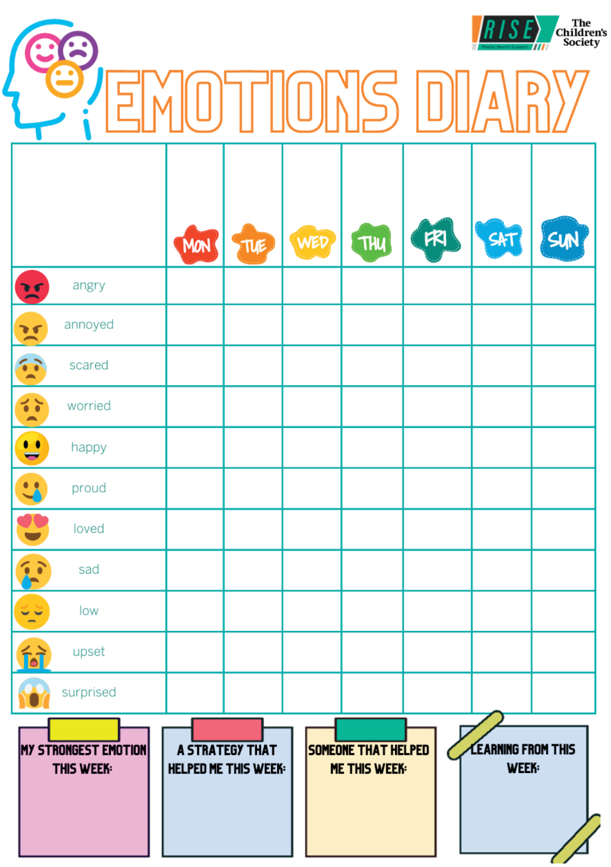

Slide 14
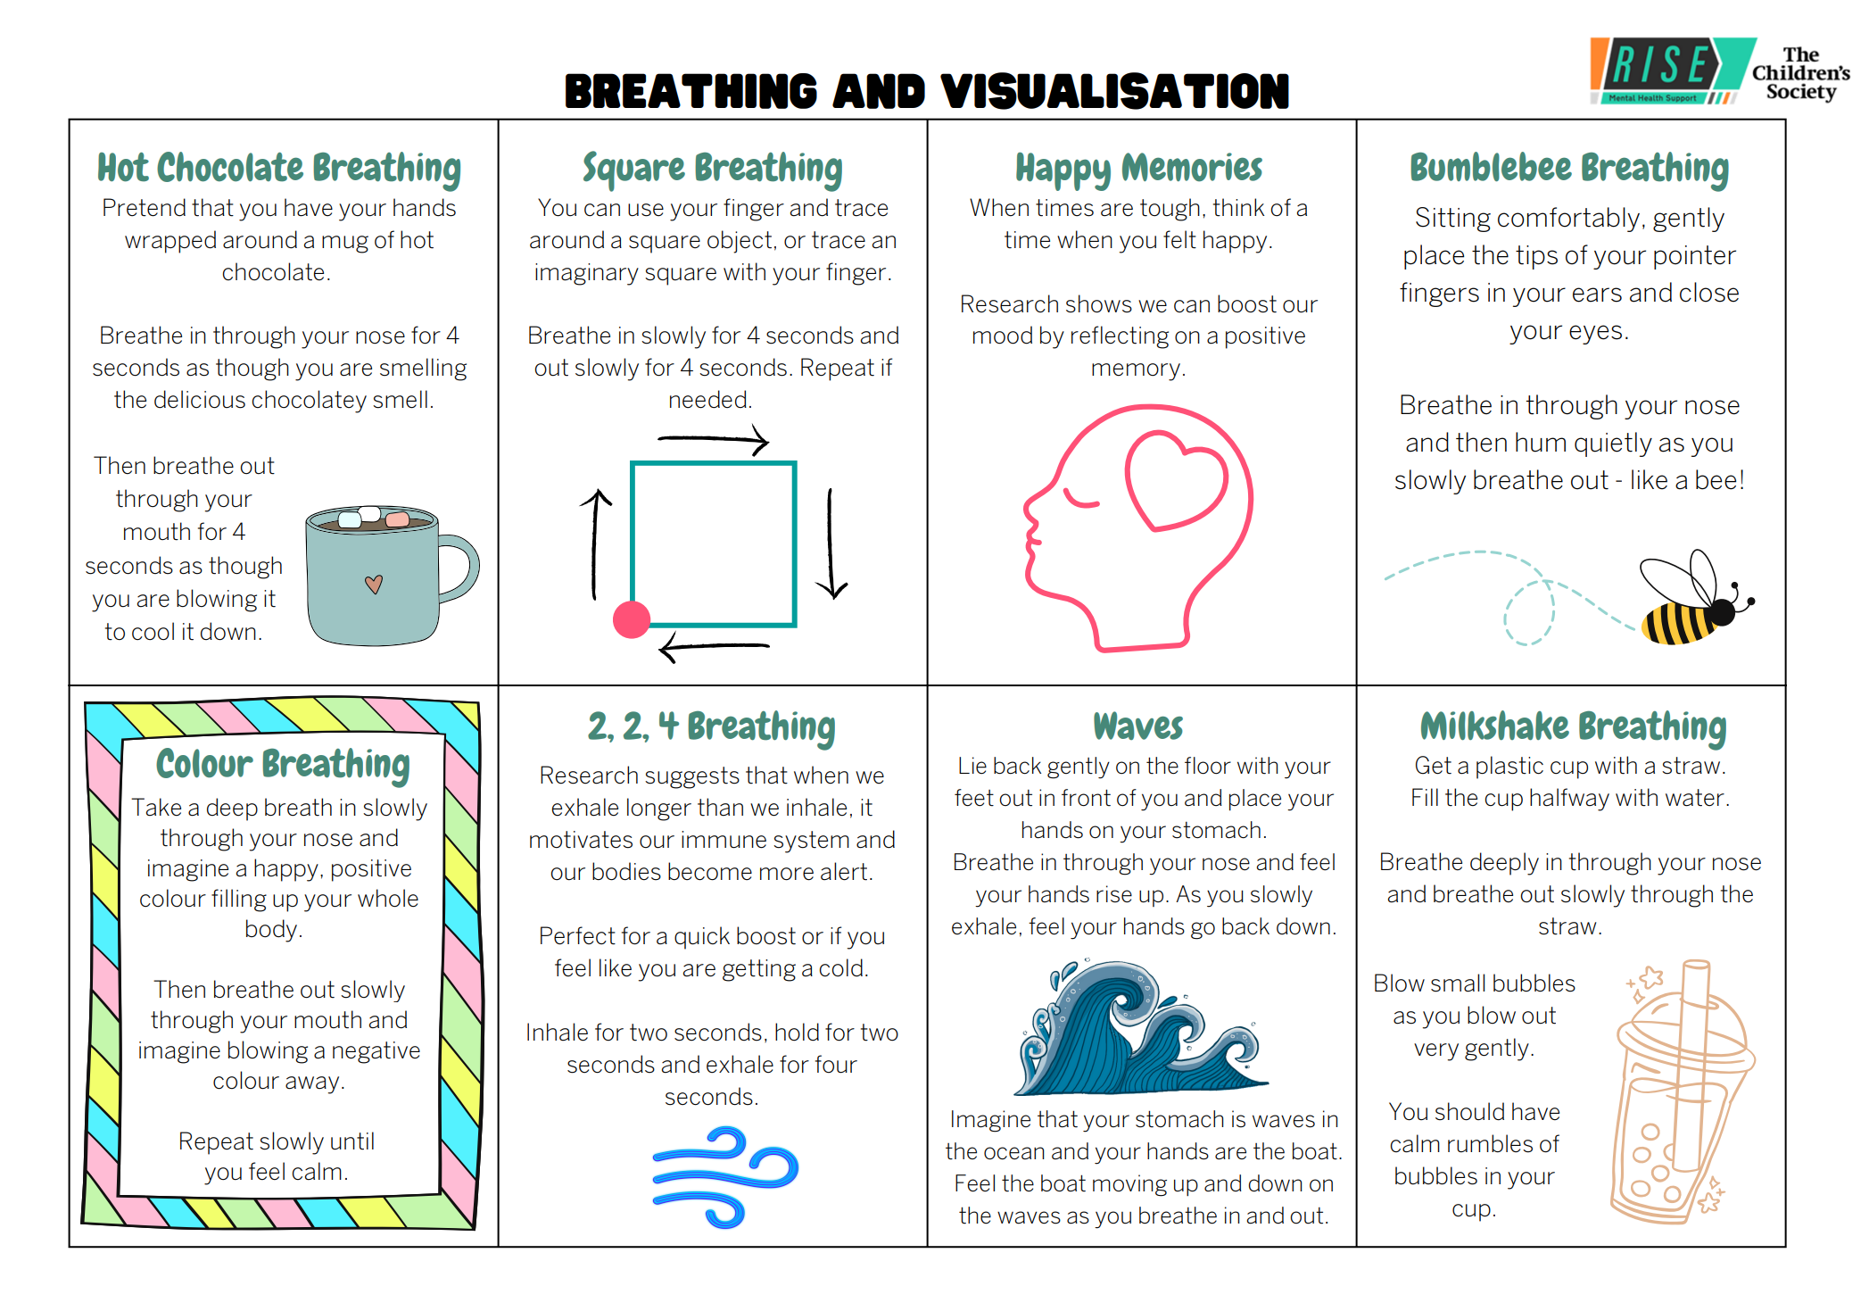

Slide 15

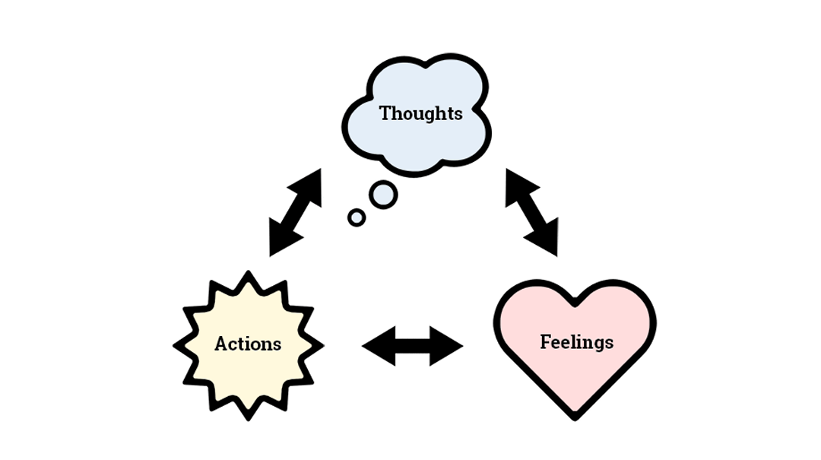
The magic triangle
Notes:
Jackie Our thoughts affect how we feel and what we choose to do. Think back to when we said we would pick a volunteer to do a task at the front- what thoughts came to your mind? How did they affect your feelings? Did anyone think about leaving to take a call or go to the bathroom?

Slide 16
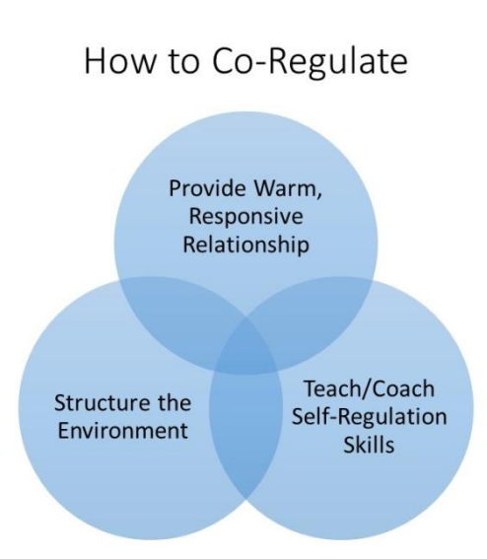
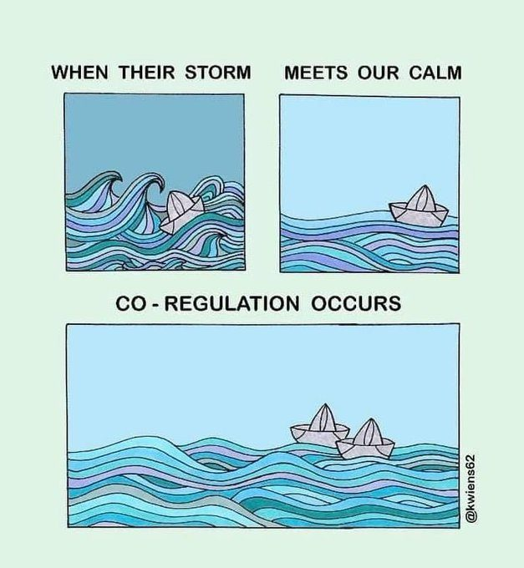
Co-regulation - Self-regulation:
Notes:
As we are supporting children with their development it may mean that we (all the adults around the child / young person) are invaluable in supporting their emotional development. Young people are still learning and developing and need things modeled for them. They need to understand that we all have emotions, sometimes they are small sometimes they are big and they need help with how to manage this.
Our role is really important here. (co-regulation)
Useful document for information on co-regulation -> Co-Regulation From Birth Through Young Adulthood: A Practice Brief (unc.edu)

Slide 17
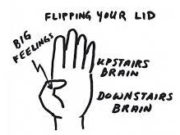
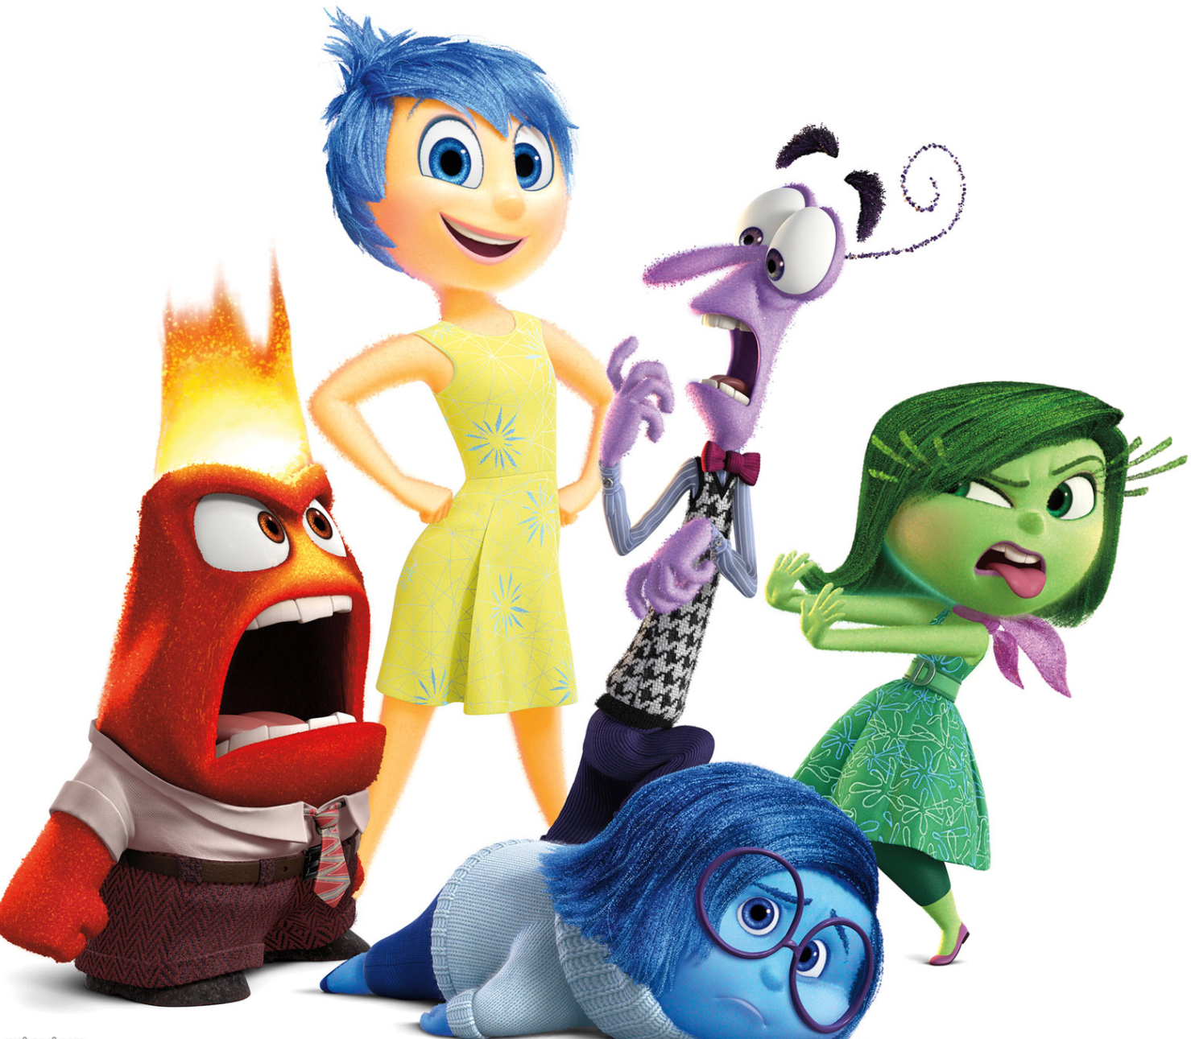
Normalise talking about and exploring emotions
Recognise emotions aren’t good or bad
Develop understanding of why big emotions happen
Externalise emotions – drawing, characters.
Notes:
Play video. Jackie
https://youtu.be/ksNrtQToJDU
https://youtu.be/ksNrtQToJDU
Explain the video is aimed at young people but it might be helpful to actually show the students. It’s a good visual when discussing emotions and behaviours e.g. using the hand model, are we close to flipping our lids? Do we need to do some strategies? Like deep breathing? Next slides show our resources i.e. where you can find some deep breathing cards.

Slide 18
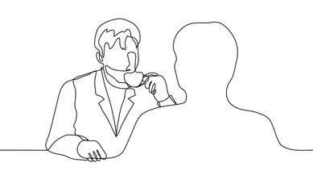
Holding Space for the Young Person
The act of being able to sit in silence and be with them in their distress and for the young person to know you are there and care for their well-being
Date
Notes:
jackie

Slide 19
Emotional Coaching:
Notice the emotion
(‘It looks like you are feeling … I wonder if that’s because . . .’)
Normalise
(‘Lots of children feel like that when . . .’)
Set limits
(‘But it’s not Ok to . . .’)
Problem solve
(‘I wonder if it would help to . . .’)
Notes:
jenny

Slide 20
Playfulness
PACE Approach- Dan Hughes
Acceptance
Curiosity
Empathy
Date

Slide 21
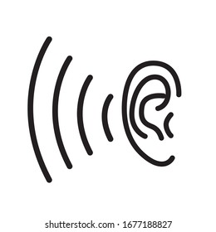
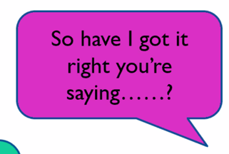
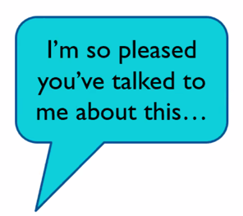
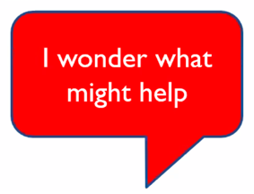
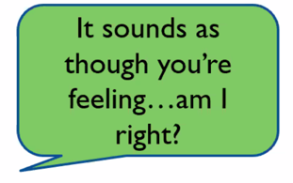
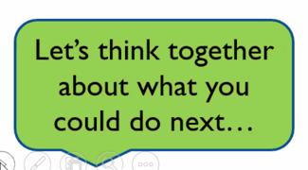
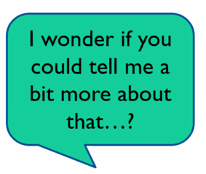
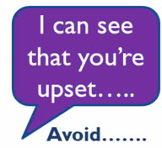
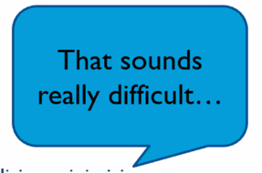
Active Listening:
Avoid: rescuing, trivialising, minimising
Encourage: openness, tentative, explorative talk
Notes:
jenny

Slide 22
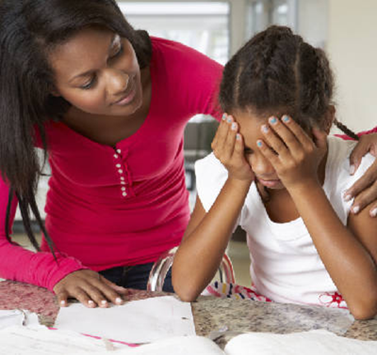
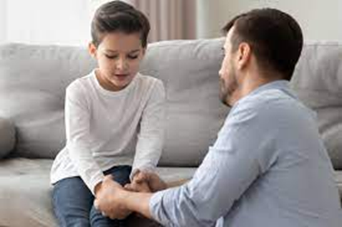
Parents & carers are the expert in their children and play a big part in helping manage their emotions.
Being more mindful of our behaviours and conversations around our children & young people can help reduce their worries/ big emotions.
Notes:
As adults, we need to try our best not to let our children see or hear these things as they are not mature enough to fully understand situations, which increases their anxiety/worry. Jenny
Making sure adult issues are only discussed with adults. We know children can interrupt us when we are having these private conversations but its stepping back and stopping this conversation with friends, family and partners to reduce what your children are hearing.
This isn’t eliminating all difficulty and the ups and downs of family life for children, its about being mindful about how overheard and glimpses of conversations can become big things for children and if anything needs to be shared it can be done at a time with your child using easily understandable language in a calm environment. E.g. with the current cost of living crisis you might be changing baths for showers but explaining this is because of saving our family money rather than explaining that bills have been increased by ££££.
SARAH

Slide 23
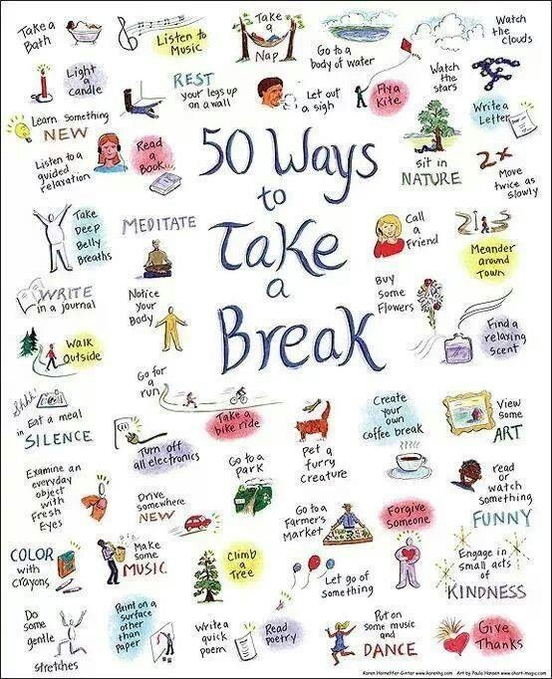
What can we do to look after ourselves?
Notes:
Jenny

Slide 24
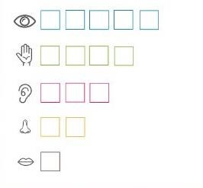


Grounding techniques:
5 senses trick:
Colours: Find 5 things in the room that are blue/ yellow etc.
Flow Activities
Flow activities are activities that take your full attention, where you ‘lose yourself’ in the activity and don’t notice time passing. Some examples might be reading a book, watching a film or playing a musical instrument. Have a think about which activities are ‘flow activities’ for you.
Notes:
Jackie Facing our fears can be scary so it’s helpful to use coping strategies and relaxation when our bodily symptoms start. One way to ground yourself in the moment is to use the 5 senses trick (find 5 things you can see, 4 things you can hear, 3 things you can touch, 2 you can smell, 1 you can taste). Flow activities are different for different people. Count back from 20 in 2s
Describe something you can see in detail
Spell the names of your family
Find different colours around you
A- Z Game
Rachel

Slide 25

Breathing exercises:
Exercises that help you control and slow your breathing down. You can find many examples of these online. One example is hand breathing:
Hold up your hand in front of you
Use the forefinger of your other hand to trace around each finger
As you go up the finger breathe in deeply, as you go down the finger breathe out deeply
Notes:
Jackie

Slide 26

Notes:
Any questions? Useful links and numbers (including Rise website) handout/ or ask school to email if virtual.

Slide 27



Find us online...
@rise.ne
We hope you enjoyed this workshop!
@rise_mhst
http://youtube.com/@rise-ne
Check out the RISE YouTube channel for more well-being videos!
rise.childrenssociety
.org.uk/

Slide 28
Helpful vs. Unhelpful thoughts:
If working with Rise, children learn that their thoughts can impact how they feel and act.
As adults we can support children to notice when they’re having an unhelpful thought that is making them feel bad, and help them to think of a different more positive thought so that they feel less anxious or upset.
Example: IF your child comes home very upset about an interaction in school, you can support them to THINK about it in a different way that makes them feel calmer or happier.
Notes:
jackie

Slide 29
Thoughts are powerful
Mistakes are a part of getting better at things
I am going to fail
I am rubbish at this
Having a go is better than not trying at all
People will admire me for not giving up
I am going to get better
Everyone will laugh at me
I can keep trying
Notes:
Jackie Which thoughts do you think are helpful to helping you succeed? We can call these green thoughts. Jackie
We can often have red thoughts but we don’t have to listen to them if they are unhelpful. We can choose to have green thoughts. It can be tricky to change red thoughts to green thoughts at first but this gets easier with practice.

Slide 30
Co-regulation
Co-regulation is a skill we learn as we grow up
We are not born with self regulation skills –they are learned from those around us
Co-regulation means helping someone regulate their own feelings and emotions simply by being there
Date
Notes:
jackie

Slide 31
Why Co-regulation?
Enables the person being regulated to feel SAFE
Enables emotional connection
Encourages EMOTIONAL CONNECTION
Adults already have self-regulation skills
Children need to develop calm down skills
Date
Notes:
jackie

Slide 32
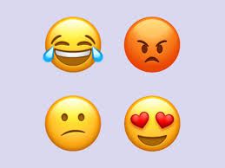
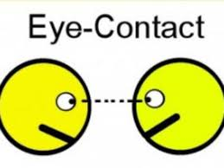
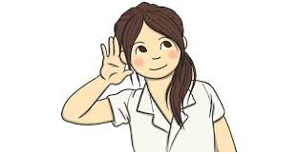

Notice Emotion
When we are out of control -logic system is broken
Cannot think clearly
Brain is in fight, flight or freeze mode
Remember its not about you!!
Self regulate before you co-regulate
NOTICE
Self Regulate
RESPOND not REACT
Notice the emotion
Grounding
Gentle Eyes
Strategies
Eye Contact(Emotional Connection)
Harmonise
Breathing
Distraction
Mindfulness
Hold Space
Grounding
Acknowledge
Body Language
I will help…
I am listening..
Empathise
I am here…
Talk less
Slow breath
Safe Space
Adults must be the haven in the storm!
We must always calm our storm first
Listen
Gentle Eye Contact
I understand…
Co-Regulate
Touch
Attune
Don’t Judge
Calm, Direct
Co-regulation
Slow Speech
Connect
Notes:
JAckie

Slide 33
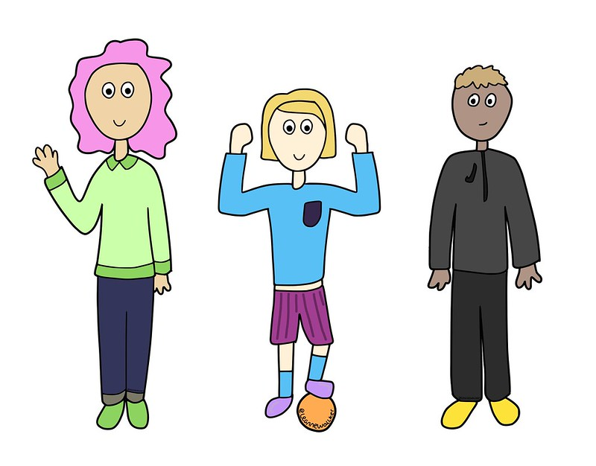
What can parents/carers do?
Empathise – try these statements…
I can see you might be feeling worried/annoyed/anxious/ sad…
That must feel scary for you…
It must be difficult when you feel worried/scared/anxious…
Normalise emotions – try these statements…
When I was little I was worried about…
Everyone feels angry or upset sometimes…
Lots of children feel anxious/scared of…
It’s hard isn’t it?
Notes:
jenny

Slide 34

Encourage conversations about feelings, worries and concerns
Create a safe space where your child feels like they can talk openly about what they are worrying about.
Be sure to validate feelings and let children know that is normal to experience anxiety or worry. This is crucial for children to not feel like they are weird or strange.
Plan a short 10-15 minutes per day of “Special time” where you and your child do something child-led together and they have your full attention.
Notes:
Create a safe space where your child/young person feels like they can talk open about what they are worrying about. This can be making sure your doing a fun activity like lego, drawing or on the way to somewhere fun like the park. Jenny
Make sure these conversations are not seen as a punishment but happen organically and not too close to bedtime so any worries spoken about can be problem solved if needed.
This can be done by writing things down on post-its, drawing, pictures or acting out if they find it hard to verbally explain their feelings.
Be sure to validate their feelings and let them know that is normal to experience anxiety or worry- this can really help children/young people not feel like they are weird or strange.
Rachel

Slide 35
Body scan
Remember: you are in control of the body scan!
https://youtu.be/ihwcw_ofuME
Notes:
This mindfulness exercise is at the beginning of most of the sessions to help pupils feel calm and in control.
!!!Remind students . “Remember, if you don’t feel comfortable focusing on your body then do it only for as long as feels okay and then find a focus for your attention that feels okay and settle on this while we do the body scan”
( e.g. stay in the same relaxed alert position but perhaps invite your attention to settle on one area of your body that might feel okay to you, like the head areas or you may chose to focus your attention outside the body)
https://youtu.be/ihwcw_ofuME

