Slide 1

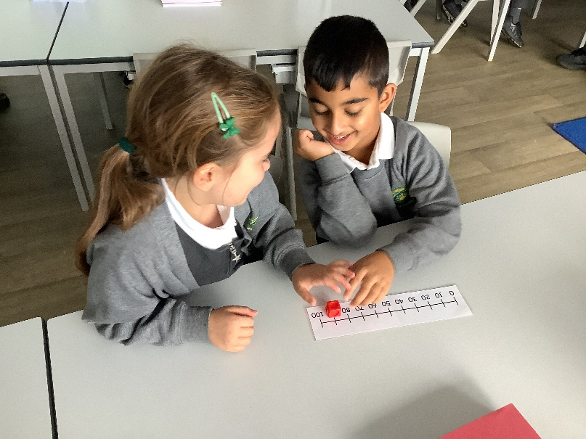
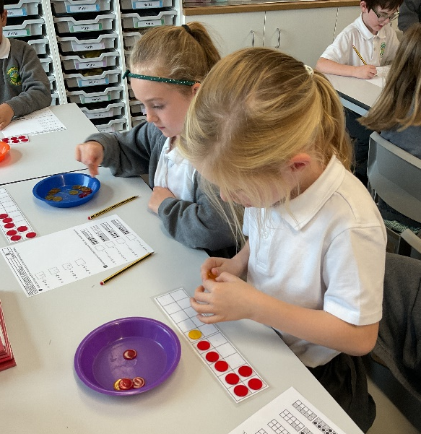
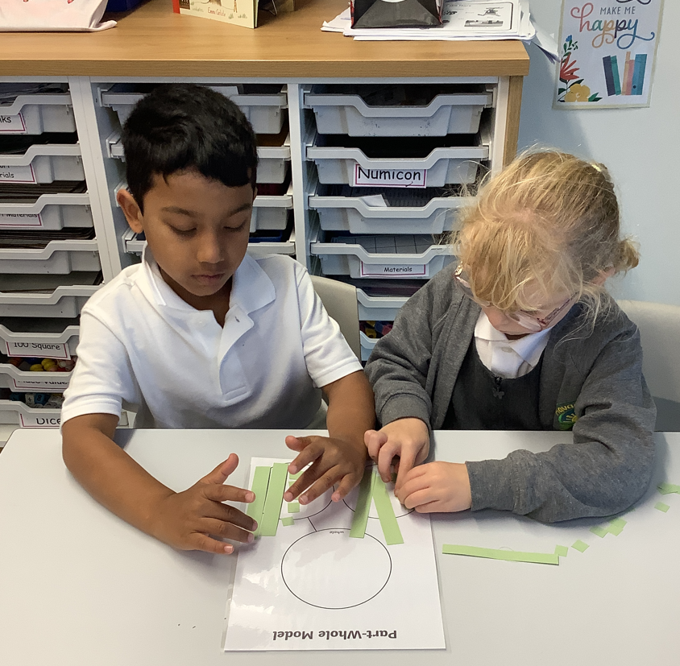
Year 2 Maths at Havannah First School
Challenge, Equality & Opportunity

Slide 2
Mastery – What is it?
Mastery in Maths is being able to understand and apply knowledge to different contexts and situations.
It can also be explaining thought processes, as well as, proving and giving reasons for answers.
This approach aims to broaden children’s understanding of a concept, enabling them to use what they know in new situations.

Slide 3
Stages of Mastery
Fluency in Maths happens when children can answer questions accurately using recall of Mathematical facts.
Reasoning is when a child can explain what they have done and why, or prove that something is or isn’t correct.
Problem solving is applying their knowledge and understanding to multi-step problems.

Slide 4
Stages of Teaching
Maths learning should follow a process, moving through each stage when the child is ready.
If the child is moved too quickly through the concrete and pictorial stage of their learning, this could affect understanding in later years.
Concrete
Pictorial
Abstract

Slide 5
How Maths is taught at Havannah
In Key Stage One, Maths is taught 5 times in a week.
We follow the White Rose Maths Schemes of Learning, which support our school’s mastery approach and are fully aligned with the National Curriculum.
Number is central to our curriculum, and we spend significant time developing strong number skills. This builds secure foundations so children can confidently access all other areas of maths.
Planning includes regular opportunities to revisit and strengthen previously learned skills.
We aim for children to stay within their Key Stage to build a deep understanding and secure knowledge in each area of learning.
The vast majority of children progress through the curriculum at a similar pace.
Support and challenge are built into every lesson to ensure all children can succeed and make progress.

Slide 6
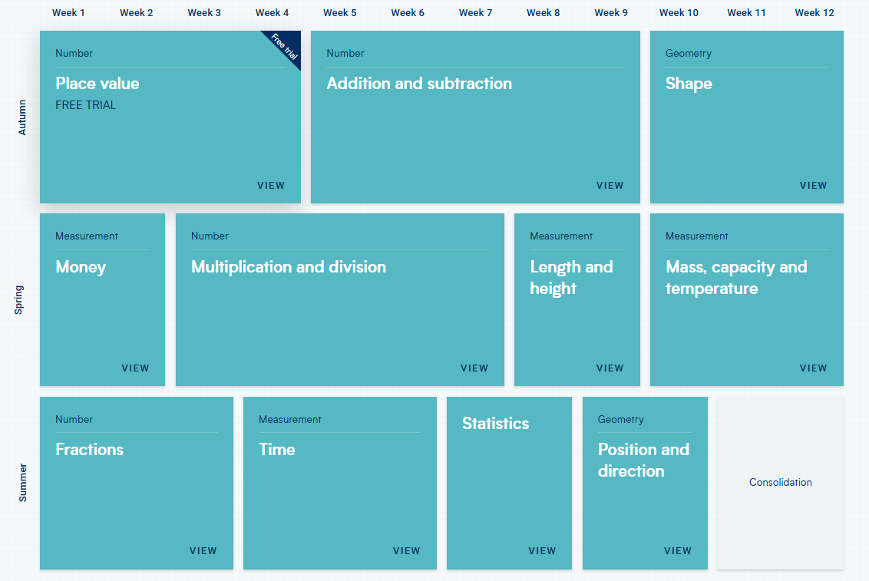
Long Term Plan for Maths- Year 2

Slide 7
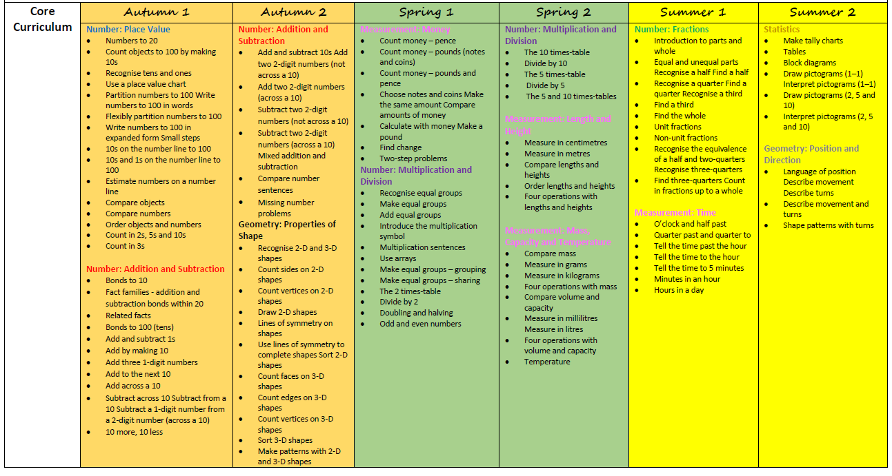
Small Steps in Maths

Slide 8
What does Maths Mastery look like in our lessons?
We break learning into small, manageable steps and ensure each step is mastered before moving on.
Previous learning is regularly revisited to build fluency and confidence.
We use visual representations and practical equipment to help children understand mathematical concepts.
Pupils are given opportunities to reason, solve problems, and make connections, which helps them remember and apply their learning
Every child receives the support or challenge they need to make progress and succeed.

Slide 9

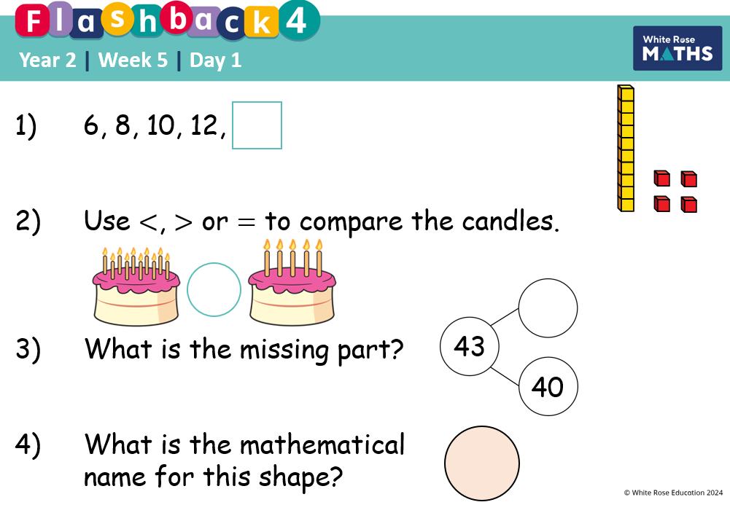
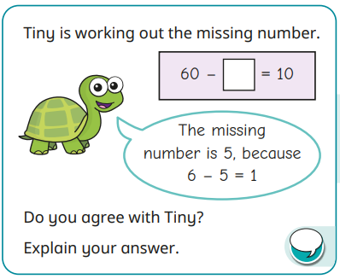
A typical Maths lesson at Havannah
Each KS1 and 2 lesson typically follows the following format:
1. Flashback 4- Daily retrieval questions from previous lessons, weeks, or earlier learning.
2. Starter activity – Practice key skills and introduce important vocabulary for the lesson.
3. Talk activity – Discuss what children already know and build on prior knowledge.
4. Open questioning task - Engage all learners through discussion of strategies.
5. A range of questions which encourages reasoning/strategies – “How do you know?”, “What’s the same and different?” etc.
6. Misconception question – Explore common misconception related to the current step.
7. Independent Practice – Fluency, reasoning, and problem-solving tasks completed in books.
8. Recap of lesson and discussion of problem- solving task.

Slide 10
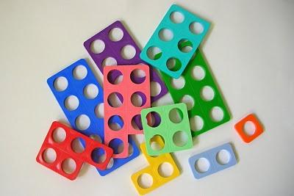
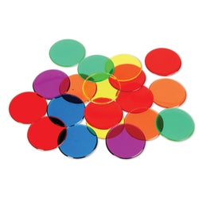
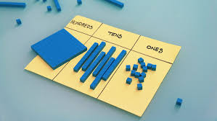
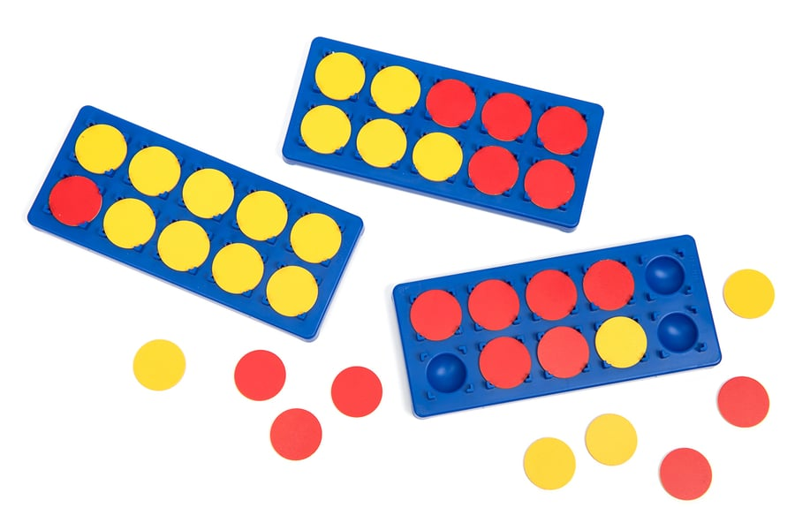
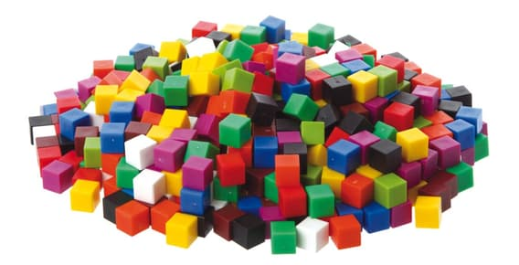
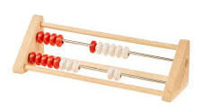
Practical resources we use in school to support learning
Numicon | Base 10 | Counters
Ten frames and counters | Cubes | Rekenrek

Slide 11
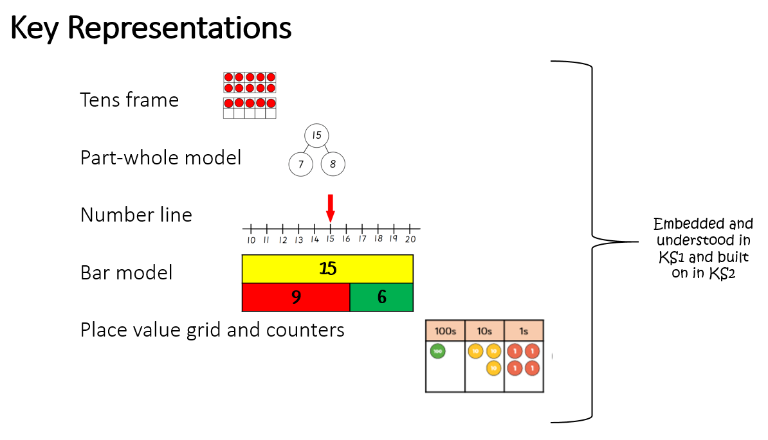
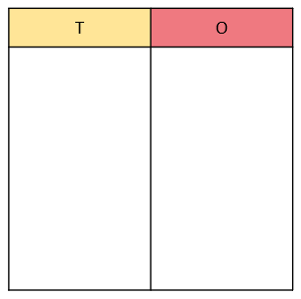
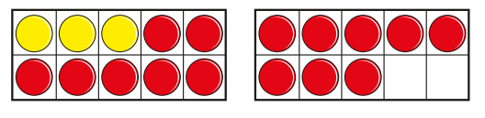
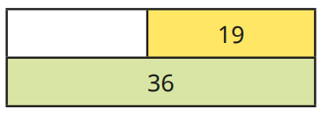
Ten frame | Place value grid
Bar model | Part whole model
Number line

Slide 12
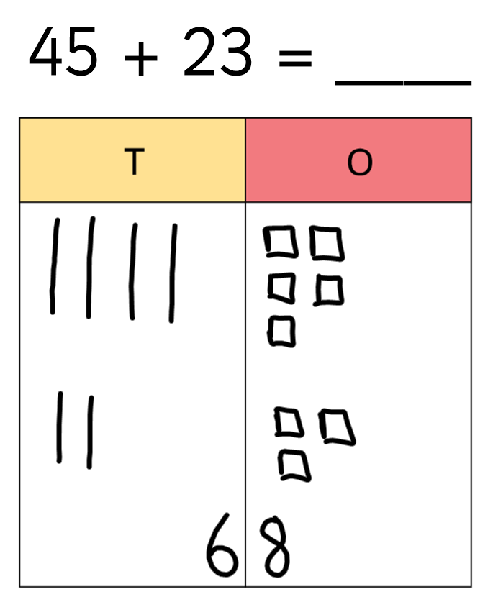
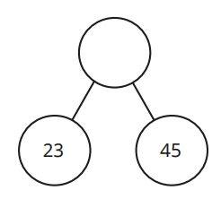
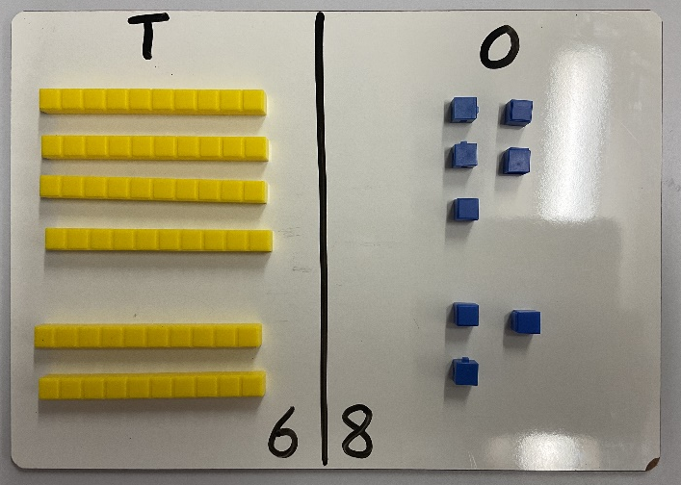
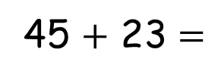
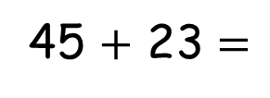
Addition
Concrete | Pictorial | Abstract
45 $+$ 23 $=$
45 $+$ 23 $=$

Slide 13
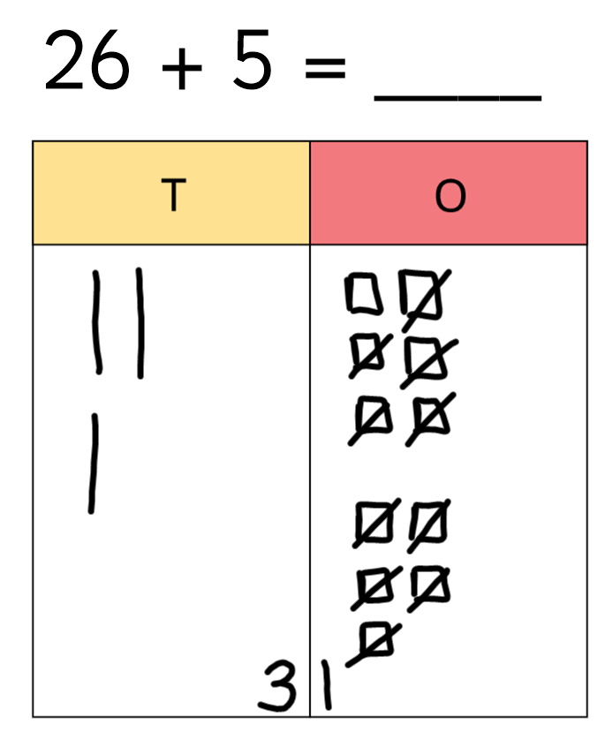
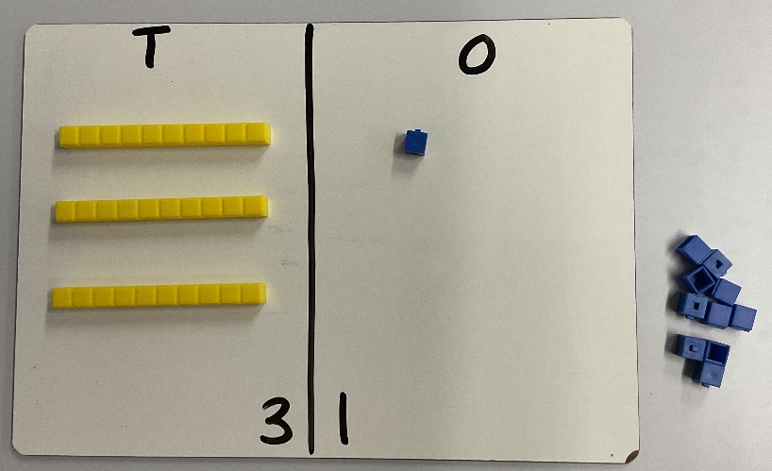
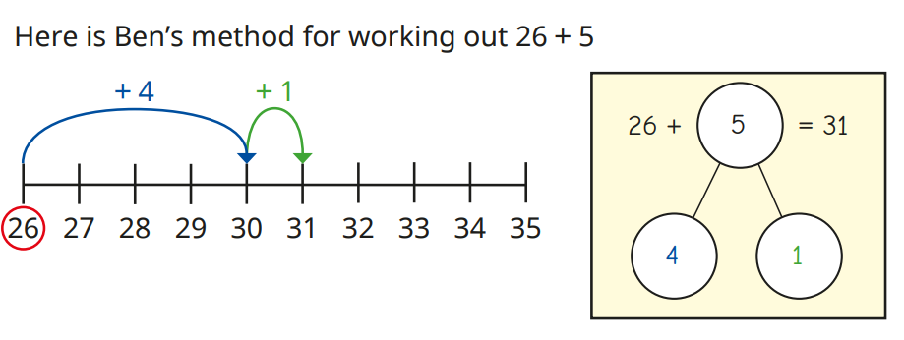
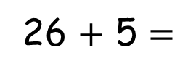
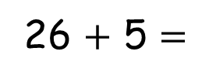
Addition- Adding across a ten
Concrete | Pictorial | Abstract
26 $+$ 5 $=$
26 $+$ 5 $=$

Slide 14
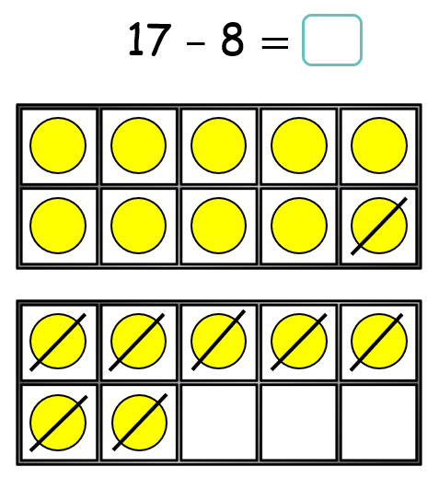
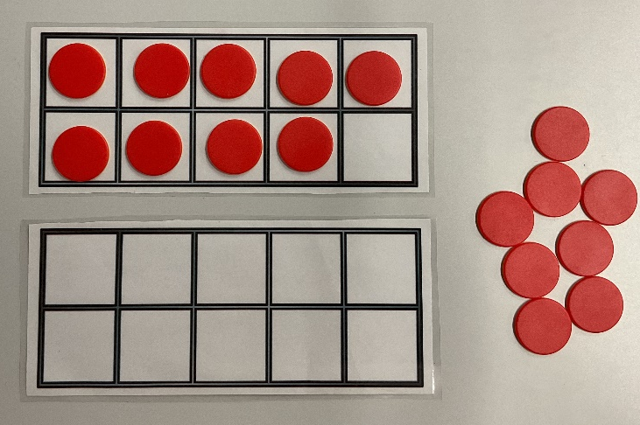
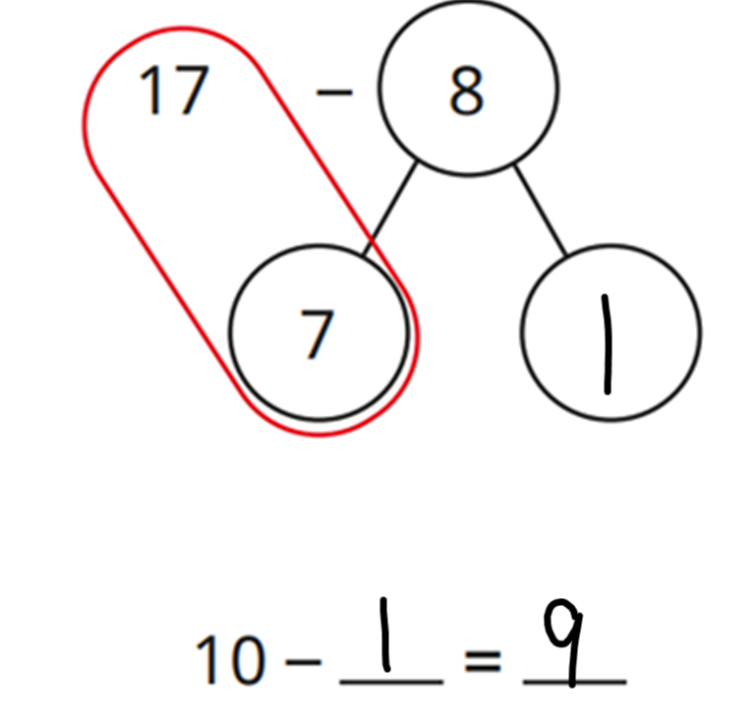


Subtraction
Concrete | Pictorial | Abstract
17 $–$ 8 $=$
17 $–$ 8 $=$

Slide 15
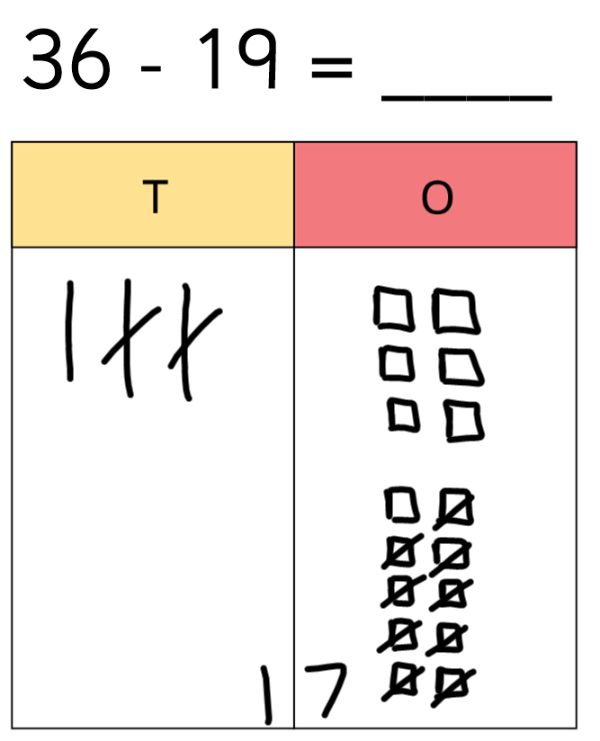
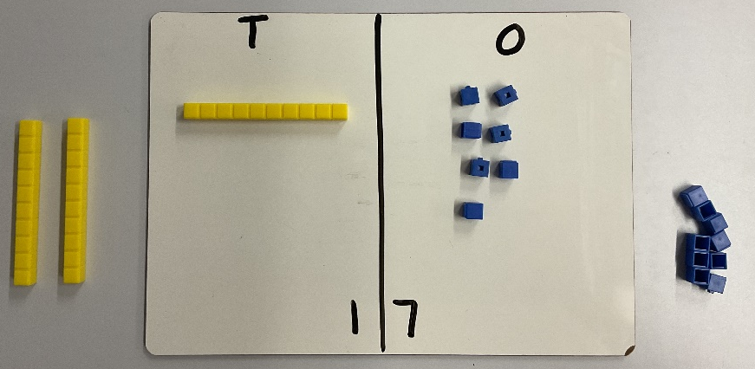


Subtraction
Concrete | Pictorial | Abstract
36 $–$ 19 $=$
36 $–$ 19 $=$

Slide 16
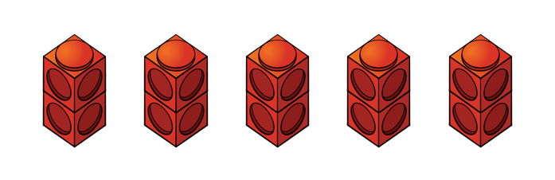
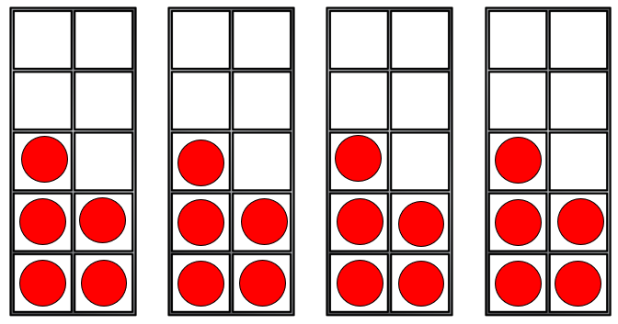
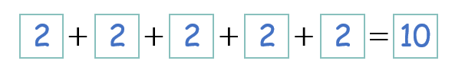
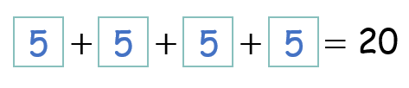
Multiplication

Slide 17
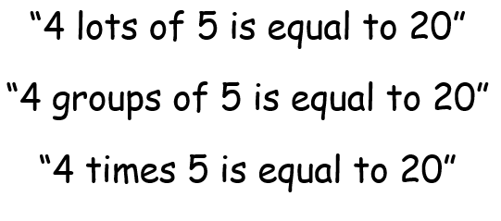
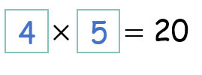
Multiplication

Slide 18
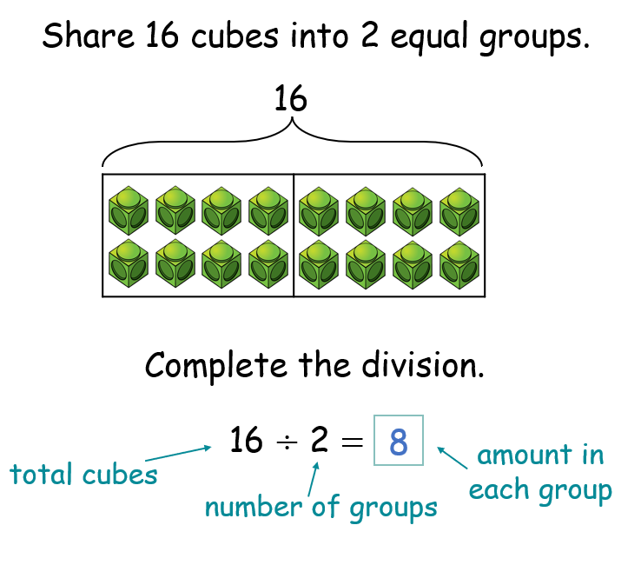
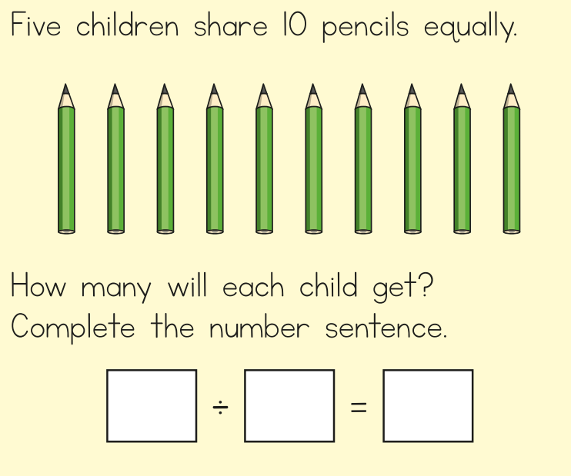
Division- Sharing

Slide 19
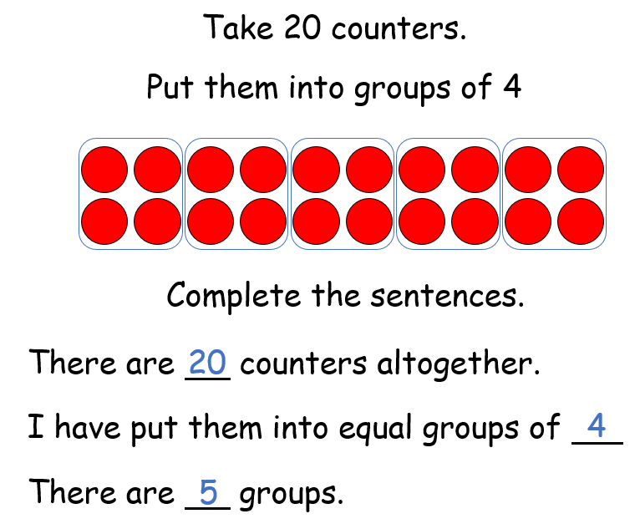
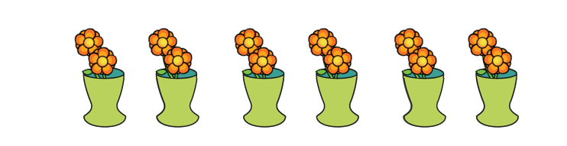
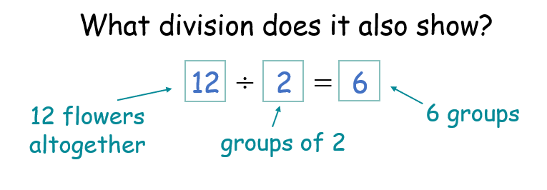

Division- Grouping
20 $÷$ 4 $=$ 5

Slide 20

Helping your child at home…
Use everyday maths:
Maths is everywhere! You can help your child notice it in daily life – at dinner, shopping, cooking, or even travelling.
Encourage your child to notice numbers, shapes, and patterns in the world around them. This could also include doubling and halving numbers. Use simple maths talk every day to help your child explore numbers and patterns.
Count, measure, and explore:
Let your child help with measuring ingredients when cooking.
Count money or items while shopping and encourage children to work out how much change they would get.
Talk about time – reading an analogue clock and estimating how many minutes until events.
Explore fractions in everyday life – for example, sharing things into halves, thirds, or quarters.
Play games: Games are not only fun but help with maths skills
Jigsaw puzzles → build logical thinking and spatial awareness.
Snakes and Ladders → practice counting and numbers.
Keep it simple and fun. Maths is part of everyday life, and little conversations can make a big difference!

Slide 21
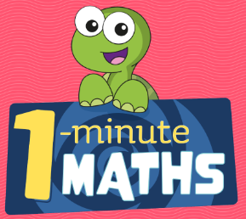
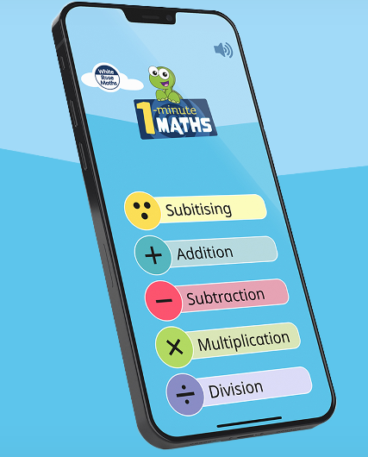

Extra Resources
Find out more about our maths curriculum on the school website or at www.whiterosemaths.com.
You can also download the White Rose ‘1-Minute Maths’ app, which is free and excellent for building fluency in number facts.
For children who need extra challenge or enjoy exploring further, try websites such as NRICH (nrich.maths.org) or Transum (transum.org).

Slide 22
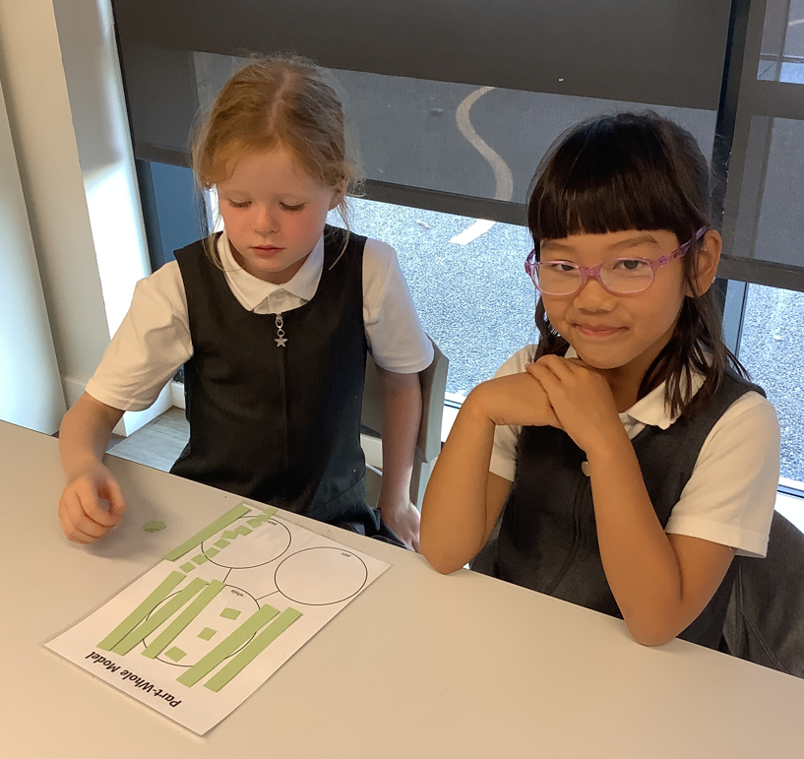
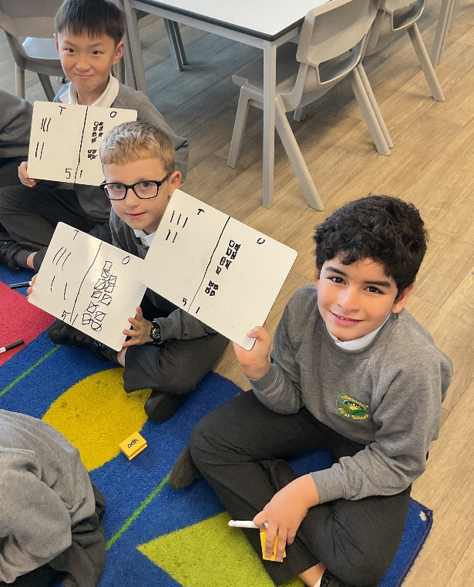
Thank you for attending. If you have any questions, please don’t hesitate to get in touch with the class teacher or with Mr Burnett, our Maths Lead. You can also visit the curriculum section on our website and follow the links to Maths.

